Slide 1
CS6456: Graduate Operating Systems
Brad Campbell – bradjc@virginia.edu
https://www.cs.virginia.edu/~bjc8c/class/cs6456-s20/

Slide 2
This week
Theme: we want correctness in our systems!
Three topics:
Testing
Verification
Security
Keeping in mind:
Scalability
Developer effort
Completeness and correctness

Slide 3
Testing
Purpose:
Verifying functional correctness (vs. spec)
Verifying software completeness - no crashes, memory leaks, assert violations…

Slide 4
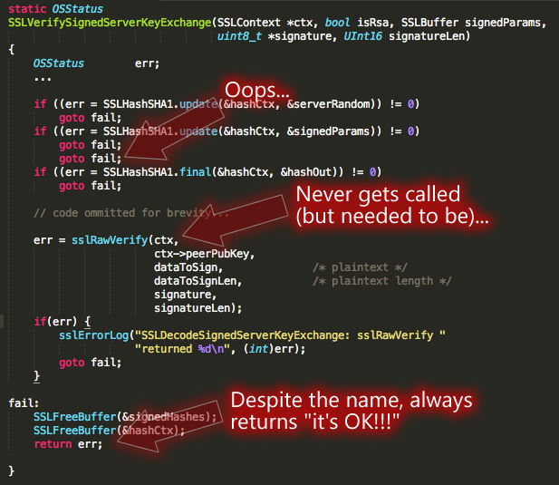
What is the goal?

Slide 5
Testing
Majority of the testing approaches are manual
Time consuming process
Error-prone
Incomplete
Depends on the quality of the test cases or inputs
Provides little in terms of coverage

Slide 6
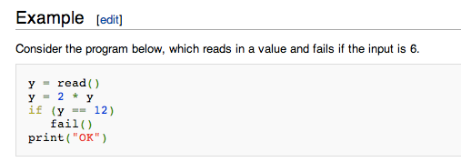

Testing: example
Can y be 12?

Slide 7
Program Validation Approaches
Static Analysis
Verification
Concolic Execution
& White-box
Fuzzing
Extended Static Analysis
Confidence
Symbolic Execution
Ad-hoc testing
Cost (programmer effort, time, expertise)

Slide 8
Random input test generation
Many more tests generated than manually
✘ Error path distribution is not uniform: Boundary values, zero-division…
example: y being a 32 bit int, many possibilities to search through

Slide 9
Automatic Test Generation Symbolic & Concolic Execution
How do we automatically generate test inputs that induce the program to go in different paths?
Intuition:
Divide the whole possible input space of the program into equivalent classes of input.
For each equivalence class, all inputs in that equivalence class will induce the same program path.
Test one input from each equivalence class.

Slide 10
Symbolic execution
Use symbols to represent variables
Guide testing based on actual source code
y is symbolic: y = s
y = 2 * s // still symbolic
Fork execution, add constraints to each path
true path constraint: 2*s==12
Need constraint solver

Slide 11
Constraint solver
2 * s == 12
CNF: ¬s1 ∧ ¬s2 ∧ ¬s3 ∧ ¬s4 ∧ s5 ∧ s6 ∧ ¬s7 ∧ ¬0
SAT solver: satisfiable? -> asserts instance -> test generate
2 * s
12
s1s2s3s4s5s6s70
00001100
00000010
s0s1s2s3s4s5s6s7
00001100

Slide 12
Background: SAT
Given a propositional formula in CNF, find if there exists an assignment to Boolean variables that makes the formula true:
literals
ω₁ = (b c)
ω₂ = (¬ a ¬ d)
ω₃ = (¬ b d)
ϕ = ω₁ ω₂ ω₃
A = {a=0, b=1, c=0, d=1}
clauses
SATisfying assignment!

Slide 13
Background: SMT
SMT: Satisfiability Modulo Theories
Input: a first-order formula ϕ over background theory
Output: is ϕ satisfiable?
does ϕ have a model?
Is there a refutation of ϕ = proof of ¬ϕ?
For most SMT solvers: ϕ is a ground formula
Background theories: Arithmetic, Arrays, Bit-vectors, Algebraic Datatypes
Most SMT solvers support simple first-order sorts

Slide 14
Example SMT Solving
EX: b + 2 = c and f(read(write(a,b,3), c-2)) ≠ f(c-b+1)
b + 2 = c and f(read(write(a,b,3), c-2)) ≠ f(c-b+1)
[Substituting c by b+2]
b + 2 = c and f(read(write(a,b,3), b+2-2)) ≠ f(b+2-b+1)
[Arithmetic simplification]
b + 2 = c and f(read(write(a,b,3), b)) ≠ f(3)
[Applying array theory axiom]
forall a,i,v:read(write(a,i,v), i) = v]
b+2 = c and f(3) ≠ f(3) [NOT SATISFIABLE]

Slide 15
Symbolic Execution --- History
1976: A system to generate test data and symbolically execute programs (Lori Clarke)
1976: Symbolic execution and program testing (James King)
2005-present: practical symbolic execution
Using SMT solvers
Heuristics to control exponential explosion
Heap modeling and reasoning about pointers
Environment modeling
Dealing with solver limitations

Slide 16
Symbolic Execution
Void func(int x, int y){
int z = 2 * y;
if(z == x){
if (x > y + 10)
ERROR
}
}
int main(){ int x = sym_input(); int y = sym_input(); func(x, y); return 0;
}
SMT solver
Path
constraint
Satisfying
Assignment
Symbolic
Execution
Engine
High coverage test inputs
Symbolic Execution

Slide 17
Symbolic Execution --- Description
Execute the program with symbolic valued inputs (Goal: good path coverage)
Represents equivalence class of inputs with first order logic formulas (path constraints)
One path constraint abstractly represent all inputs that induces the program execution to go down a specific path
Solve the path constraint to obtain one representative input that exercises the program to go down that specific path

Slide 18
More details on Symbolic Execution
Instead of concrete state, the program maintains symbolic states, each of which maps variables to symbolic values
Path condition is a quantifier-free formula over the symbolic inputs that encodes all branch decisions taken so far
All paths in the program form its execution tree, in which some paths are feasible and some are infeasible

Slide 19
Symbolic Execution (contd.)
How does symbolic execution work?
Void func(int x, int y){
int z = 2 * y;
if(z == x){ if (x > y + 10) ERROR
}
}
int main(){ int x = sym_input(); int y = sym_input(); func(x, y); return 0;
}
func(x = a, y = b)
Path constraint
z = 2b
2b != a
2b == a
x = a = 0
y = b = 1
2b == a &&
a <= b + 10
2b == a &&
a > b + 10
ERROR
Generated
Test inputs
for this path
x = a = 2
y = b = 1
x = a = 30
y = b =15
Note: Require inputs to be marked as symbolic

Slide 20
Symbolic Execution (contd.)
How does symbolic execution work?
func(x = a, y = b)
x = a = 0
y = b = 1
x = a = 5
y = b = 4
x = a = 2
y = b = 3
………
z = 2b
2b != a
2b == a
x = a = 2
y = b = 1
x = a = 40
y = b = 20
………
x = a = 4
y = b = 2
………
2b == a &&
a <= b + 10
2b == a &&
a > b + 10
x = a = 30
y = b = 15
x = a = 0
y = b = 1
x = a = -6
y = b = -3
x = a = 48
y = b = 24
ERROR
Path constraints represent
equivalence classes of inputs
x = a = 2
y = b = 1
x = a = 30
y = b =15

Slide 21
SMT Queries
Counterexample queries (generate a test case)
Branch queries (whether a branch is valid)
Path Constraints = {C₁, C₂, …, C_{n}}; SAT
If K
Use queries to determine validity of a branch
else path is impossible: C₁ ∧ C₂ ∧ … ∧ C_{n} ∧ ¬K is UNSAT
then path is impossible: C₁ ∧ C₂ ∧ … ∧ C_{n} ∧ K is UNSAT
then
else

Slide 22
Optimizing SMT Queries
Expression rewriting
Simple arithmetic simplifications (x * 0 = 0)
Strength reduction (x * 2^{n} = x << n)
Linear simplification (2 * x - x = x)
Constraint set simplification
x < 10 && x = 5 --> x = 5
Implied Value Concretization
x + 1 = 10 --> x = 9
Constraint Independence
i<j && i < 20 && k > 0; new constraint i = 20

Slide 23
Optimizing SMT Queries (contd.)
Counter-example Cache
i < 10 && i = 10 (no solution)
i < 10 && j = 8 (satisfiable, with variable assignments i → 5, j → 8)
Superset of unsatisfiable constraints
{i < 10, i = 10, j = 12} (unsatisfiable)
Subset of satisfiable constraints
i → 5, j → 8, satisfies i < 10
Superset of satisfiable constraints
Same variable assignments might works

Slide 24
How does Symbolic Execution Find bugs?
It is possible to extend symbolic execution to help us catch bugs?
How: Dedicated checkers
Divide by zero example --- y = x / z where x and z are symbolic variables and assume current PC is f
Even though we only fork in branches we will now fork in the division operator
One branch in which z = 0 and another where z !=0
We will get two paths with the following constraints:
z = 0 && f, z != 0 && f
Solving the constraint z = 0 && f will give us concrete input values that will trigger the divide by zero error.

Slide 25
Classic Symbolic Execution --- Practical Issues
Loops and recursions: infinite execution tree
Path explosion: exponentially many paths
Heap modeling: symbolic data structures and pointers
SMT solver limitations: dealing with complex path constraints
Environment modeling: dealing with native / system/library calls/file operations/network events

Slide 26
Classic Symbolic Execution --- Practical Issues (possible solutions)
Infinite execution tree
Finitize paths by limiting the PC size (bounded verification)
Use loop invariants (verification)
Path explosion
Select next branch at random
Select next branch based on coverage
Interleave symbolic execution with random testing
Heap modeling
Segmented address space via the theory of arrays (Klee)
Lazy concretization (JPF)
Concolic lazy concretization (CUTE)

Slide 27
Classic Symbolic Execution --- Practical Issues (possible solutions)
SMT solver limitations
On-the-fly expression simplification
Incremental solving
Solution caching
Counterexample caching
Substituting concrete values for symbolic in complex PCs (CUTE)
Environment modeling
Partial state concretization
Manual models of the environment (Klee)

Slide 28
Symbolic Execution Coverage Problem
Symbolic execution may not reach deep into the execution tree. Specially when encountering loops.

Slide 29
Solution: Concolic Execution
Concolic = Concrete + Symbolic
Sometimes called dynamic symbolic execution
The intention is to visit deep into the program execution tree
Program is simultaneously executed with concrete and symbolic inputs
Start off the execution with a random input
Specially useful in cases of remote procedure call

Slide 30
Concolic Execution Steps
Generate a random seed input to start execution
Concretely execute the program with the random seed input and collect the path constraint
Example: a && b && c
In the next iteration, negate the last conjunct to obtain the constraint a && b && !c
Solve it to get input to the path which matches all the branch decisions except the last one
Why not from the first?

Slide 31
Concolic Execution
Random seed
x = 2, y = 1
Void func(int x, int y){
int z = 2 * y;
if(z == x){ if (x > y + 10) ERROR
}
}
int main(){ int x = input(); int y = input(); func(x, y); return 0;
}
func(x = a, y = b)
Path constraint
z = 2b
2b != a
2b == a
2b == a &&
a <= b + 10
2b == a &&
a > b + 10
ERROR
x = a = 30
y = b =15

Slide 32


Slide 33
KLEE: symbolic executer
Architecture: compiles C code to LLVM byte code. Executes a symbolic interpreter.
Map LLVM instructions to constraints. Constraint solver: STP.
generates executable tests, independent of KLEE.
Used to check all GNU Coreutils and covered 90% lines: more coverage than the 15 year on-going manual test suite…in 89 hours.

Slide 34
KLEE - usage
Compile C programs to LLVM byte code and run KLEE interpreter with wanted parameters: $ llvm-gcc --emit-llvm -c tr.c -o tr.bc $ klee --max-time 2 --sym-args 1 10 10 --sym-files 2 2000 --max-fail 1 tr.bc

Slide 35
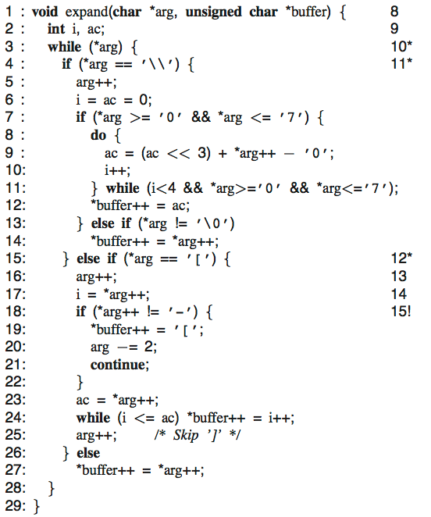
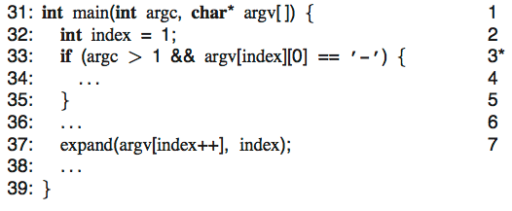
KLEE - symbolic execution: tr (Minix)
3 symbolic arguments
Fork execution
Fork, constraint arg[0]==‘[‘
Detect bug (implicit array bounds checking) and generate test: input={“[“, “”, “”}
all 37 paths in 2 minutes

Slide 36
Klee: scalability challenges
Exponential number of paths
Expensive constraint solving
Interaction with environment

Slide 37
Challenge: exponential search space
Naïve exploration can easily get “stuck”
Use search heuristics:
Coverage-optimized search
Select path closest to an uncovered instruction
Favor paths that recently hit new code
Random path search
See [KLEE – OSDI’08]

Slide 38
Challenge: expensive constraint solving
Dominates runtime
Inherently expensive (NP-complete)
Invoked at every branch
Two simple and effective optimizations
Eliminating irrelevant constraints
Caching solutions
Dramatic speedup on benchmarks

Slide 39
Eliminating irrelevant constraints
In practice, each branch usually depends on a small number of variables
…
…
if (x < 10) {
…
}
x + y > 10
z & -z = z
x < 10 ?

Slide 40
Caching solutions
Static set of branches: lots of similar constraint sets
2 ∗ y < 100
x > 3
x + y > 10
x = 5
y = 15
2 ∗ y < 100
x + y > 10
Eliminating constraints
cannot invalidate solution
x = 5
y = 15
2 ∗ y < 100
x > 3
x + y > 10
x < 10
Adding constraints often
does not invalidate solution
x = 5
y = 15
UBTree data structure [Hoffman and Koehler, IJCAI ’99]

Slide 41
Simple fixes result in dramatic improvements
Aggregated data over 73 applications
Time (s)
Executed instructions (normalized)

Slide 42
Challenge: calling OS environment
int fd = open(“t.txt”, O_RDONLY);
If all arguments are concrete, forward to OS
Otherwise, provide models that can handle symbolic files
Goal is to explore all possible legal interactions with the environment
int fd = open(sym_str, O_RDONLY);

Slide 43
Environment modeling
// actual implementation: ~50 LOC
ssize_t read(int fd, void *buf, size_t count) {
exe_file_t *f = get_file(fd);
…
memcpy(buf, f->contents + f->off, count)
f->off += count;
…
}
Plain C code run by KLEE
Users can extend/replace environment w/o any knowledge of KLEE internals
Currently: effective support for symbolic command line arguments, files, links, pipes, ttys, environment vars

Slide 44
Real world failures
int num_bytes = write(fd, buffer, 10);
Can this fail?
Yes!
Klee will occasionally return an error for syscalls.

Slide 45
Evaluation - Metrics
Line coverage, only executable: ELOC percentage
Doesn’t measure actual conditional paths used
Used also because the gcov profiler outputs it and its a common tool among testing tools.

Slide 46
Coreutils
All 89 Coreutils programs ran with command: ./run <tool-name> --max-time 60 --sym-args 10 2 2 --sym-files 2 8 [--max-fail 1]

Slide 47
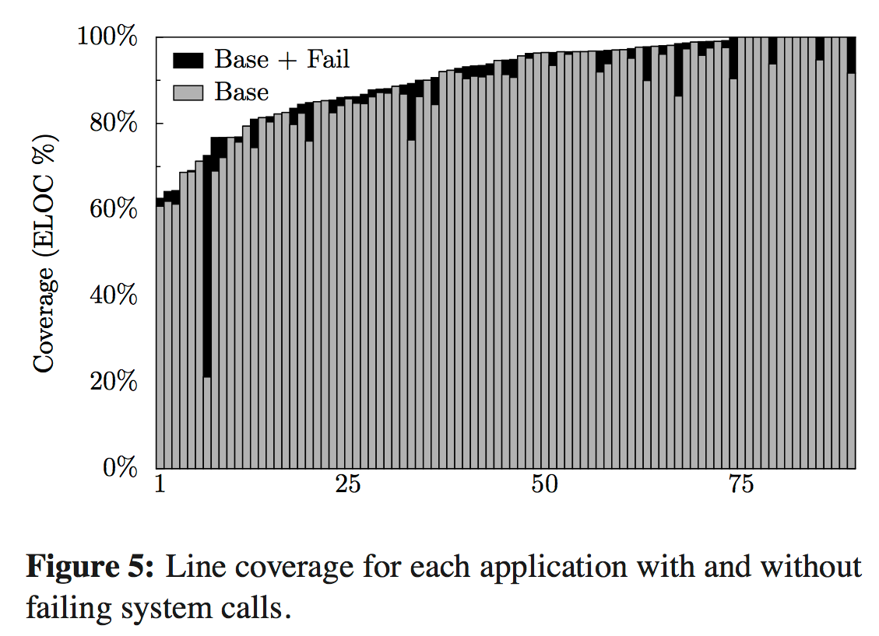

Coreutils
76.9% line coverage of all 89 Coreutils programs
pwd

Slide 48
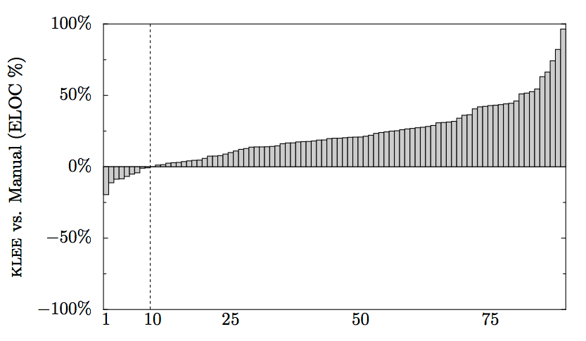
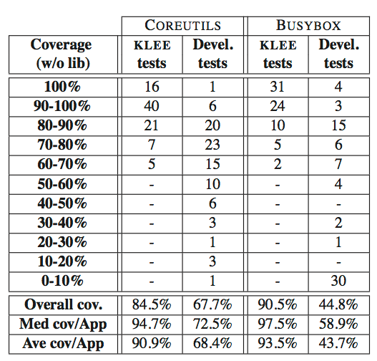
KLEE vs. manual suite
(LKLEE-Lman) / Ltotal

Slide 49
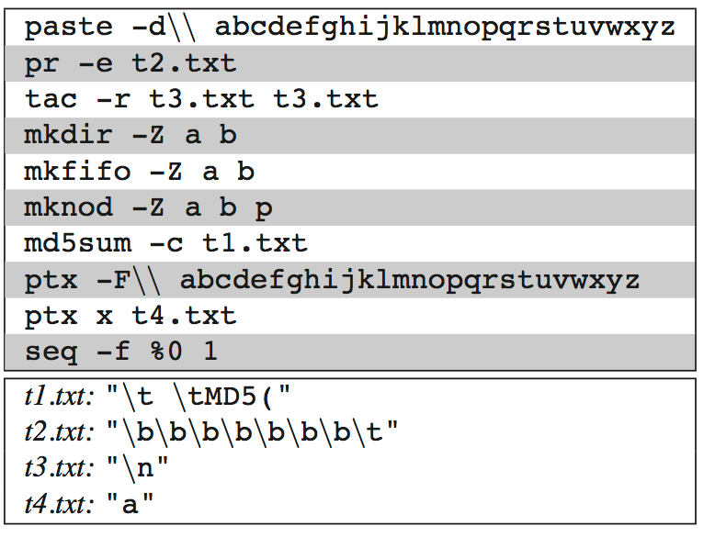
Bugs in real coreutils programs
Since 1992
Cause: modulus negative

Slide 50
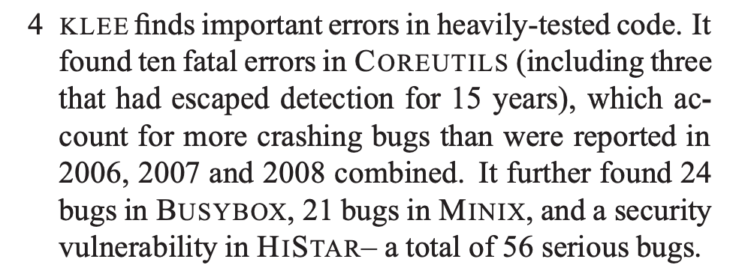
Quite a claim

Slide 51
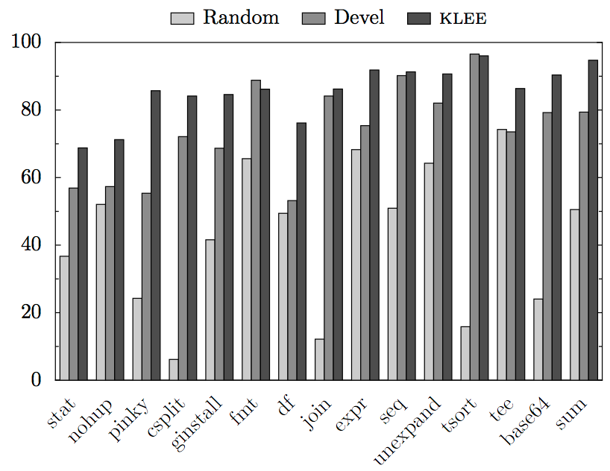
KLEE vs. random
Observation: random quickly gets the cases it can, and then revisits them over and over

Slide 52

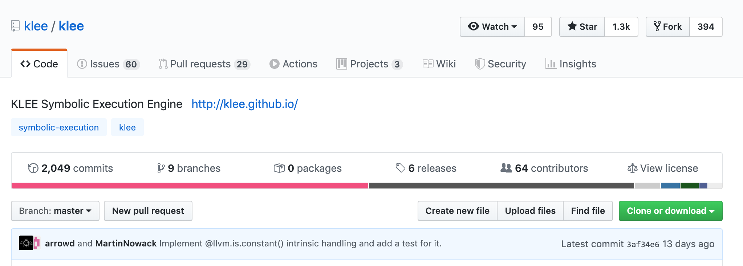


Lasting impact: KLEE today

Slide 53
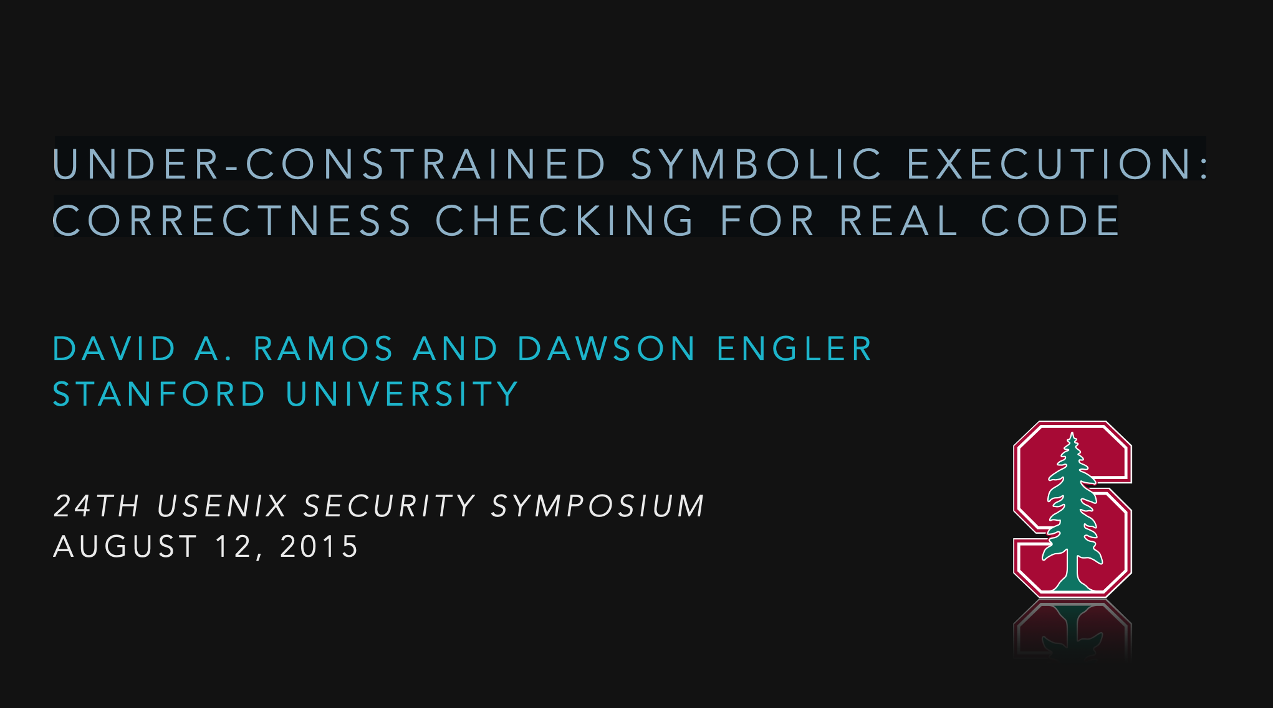

Slide 54
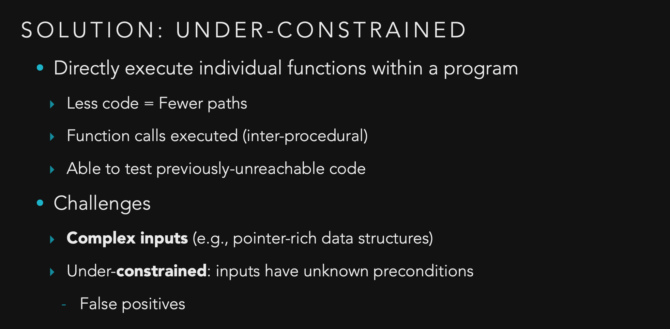

Slide 55
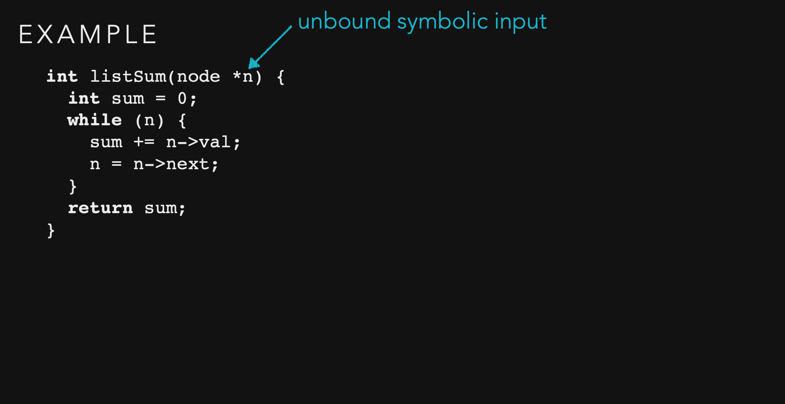

Slide 56
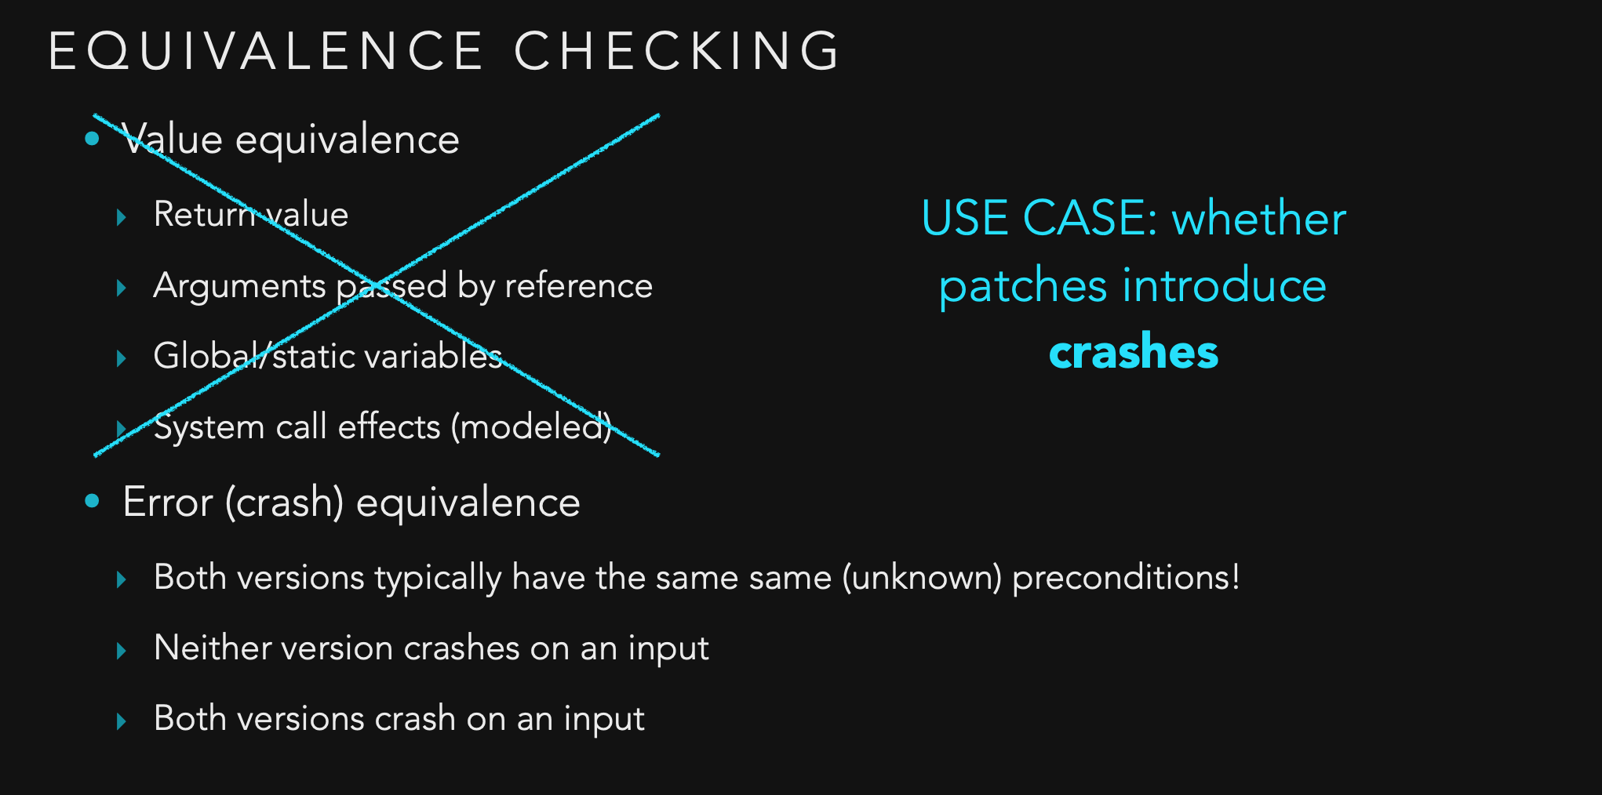

Slide 57
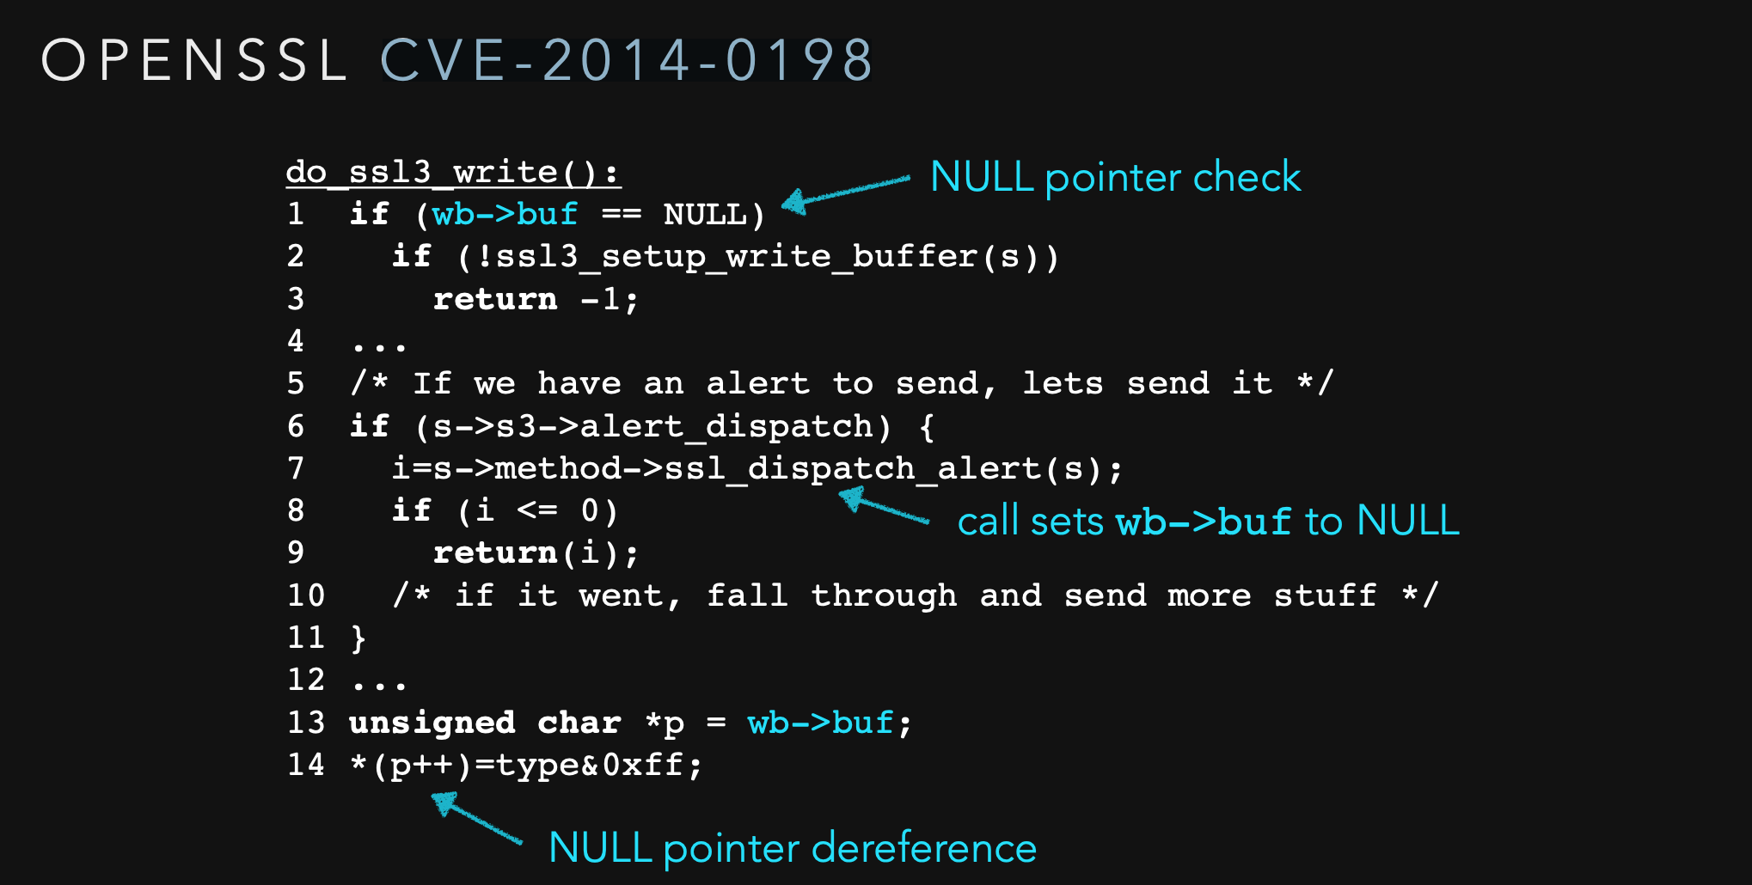

Slide 58
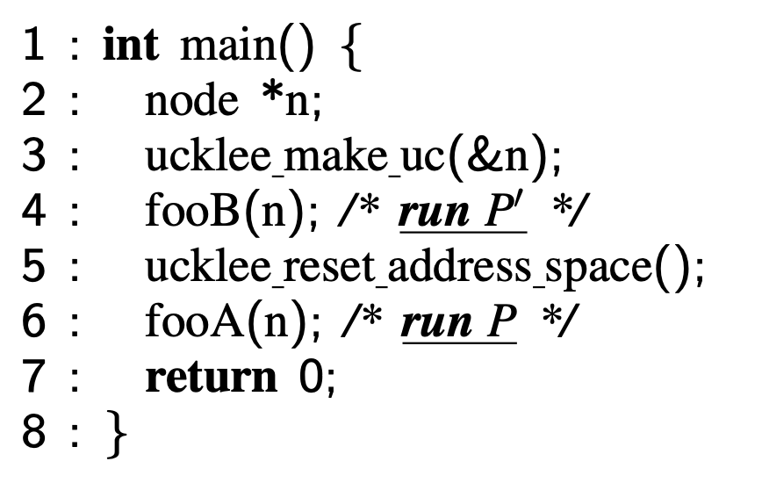
UC-KLEE patch testing
Generate unconstrained input
Run new version
When crash detected, go here
Follow same execution path in older version
Crash -> OK
No crash -> report error

Slide 59
Verification

Slide 60
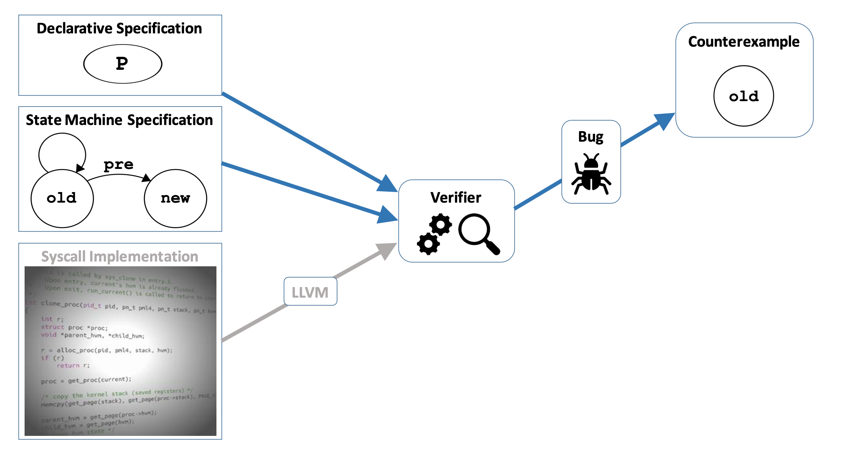
High-level view of kernel verification

Slide 61
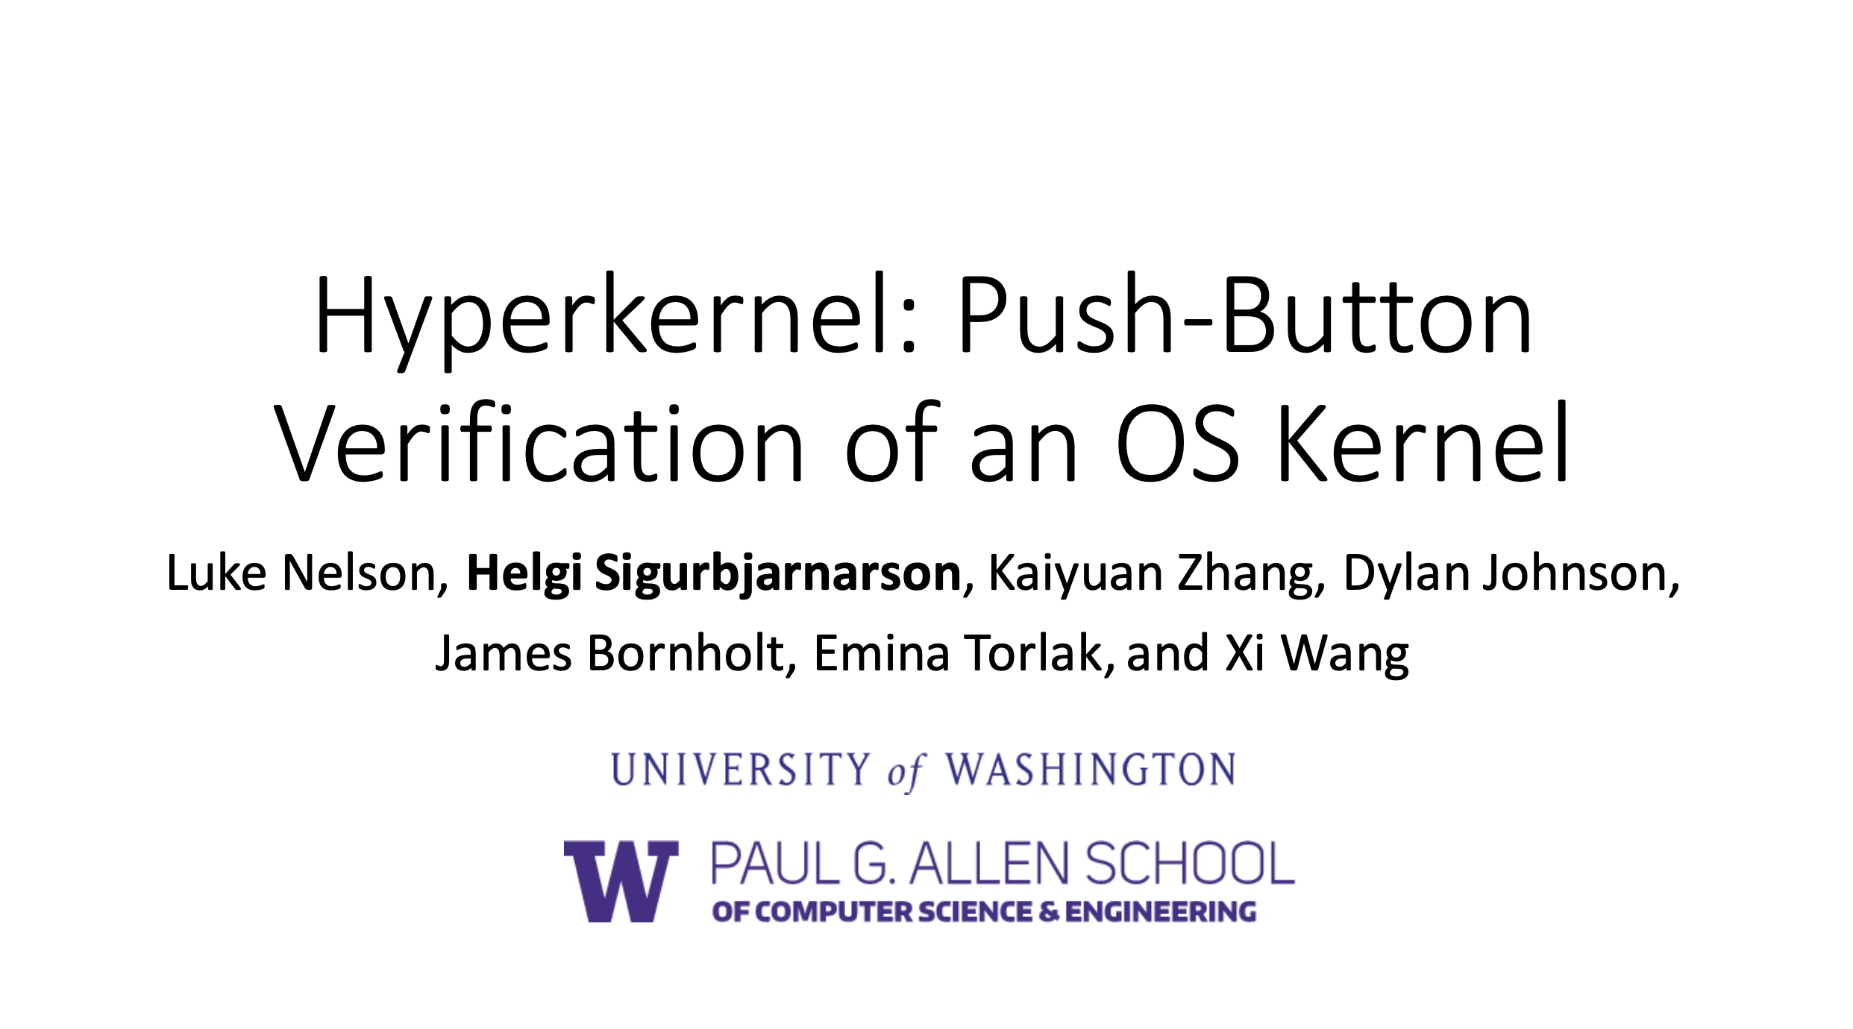

Slide 62
General goal
Write a specification of expected kernel behavior
Prove that the implementation matches the spec
Challenges:
Kernels are complex
Proofs are difficult to construct

Slide 63
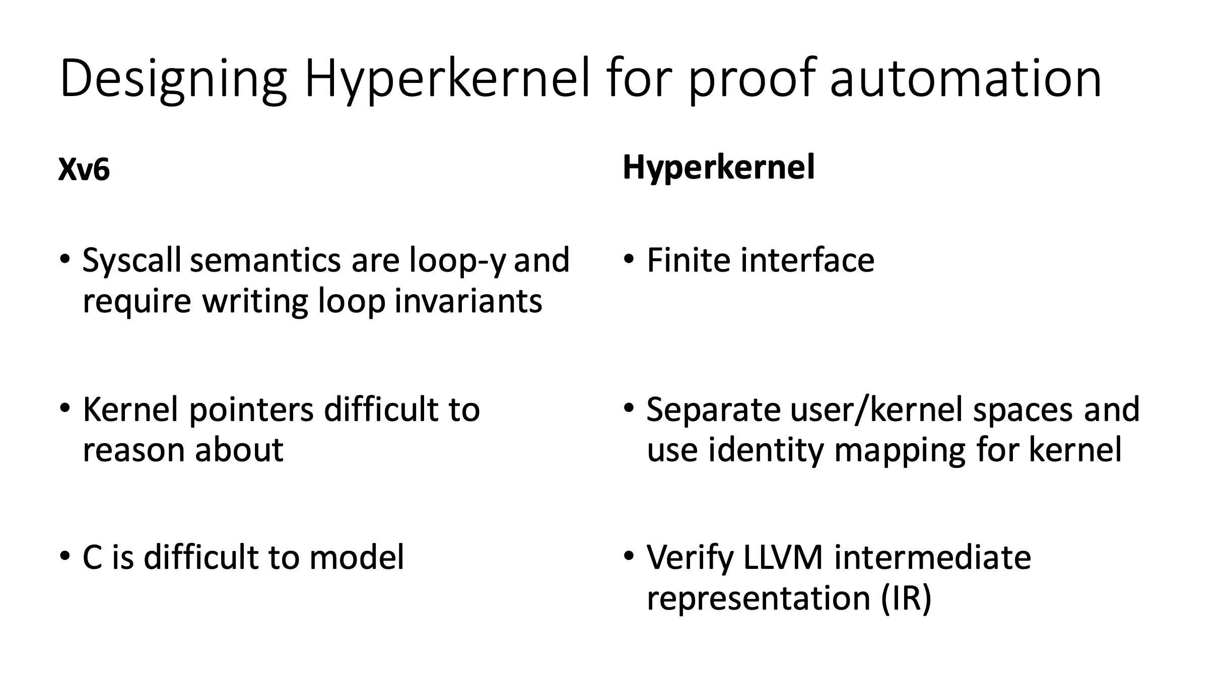

Slide 64
High-level view of kernel verification

Slide 65
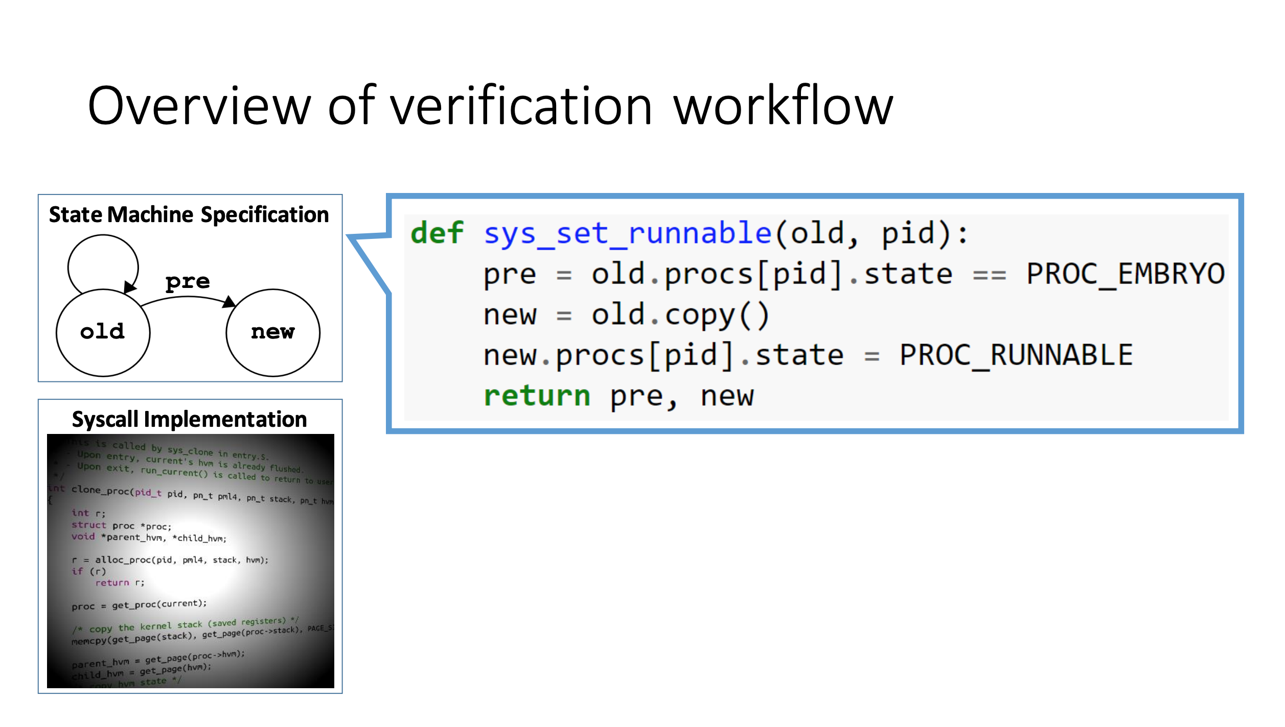

Slide 66
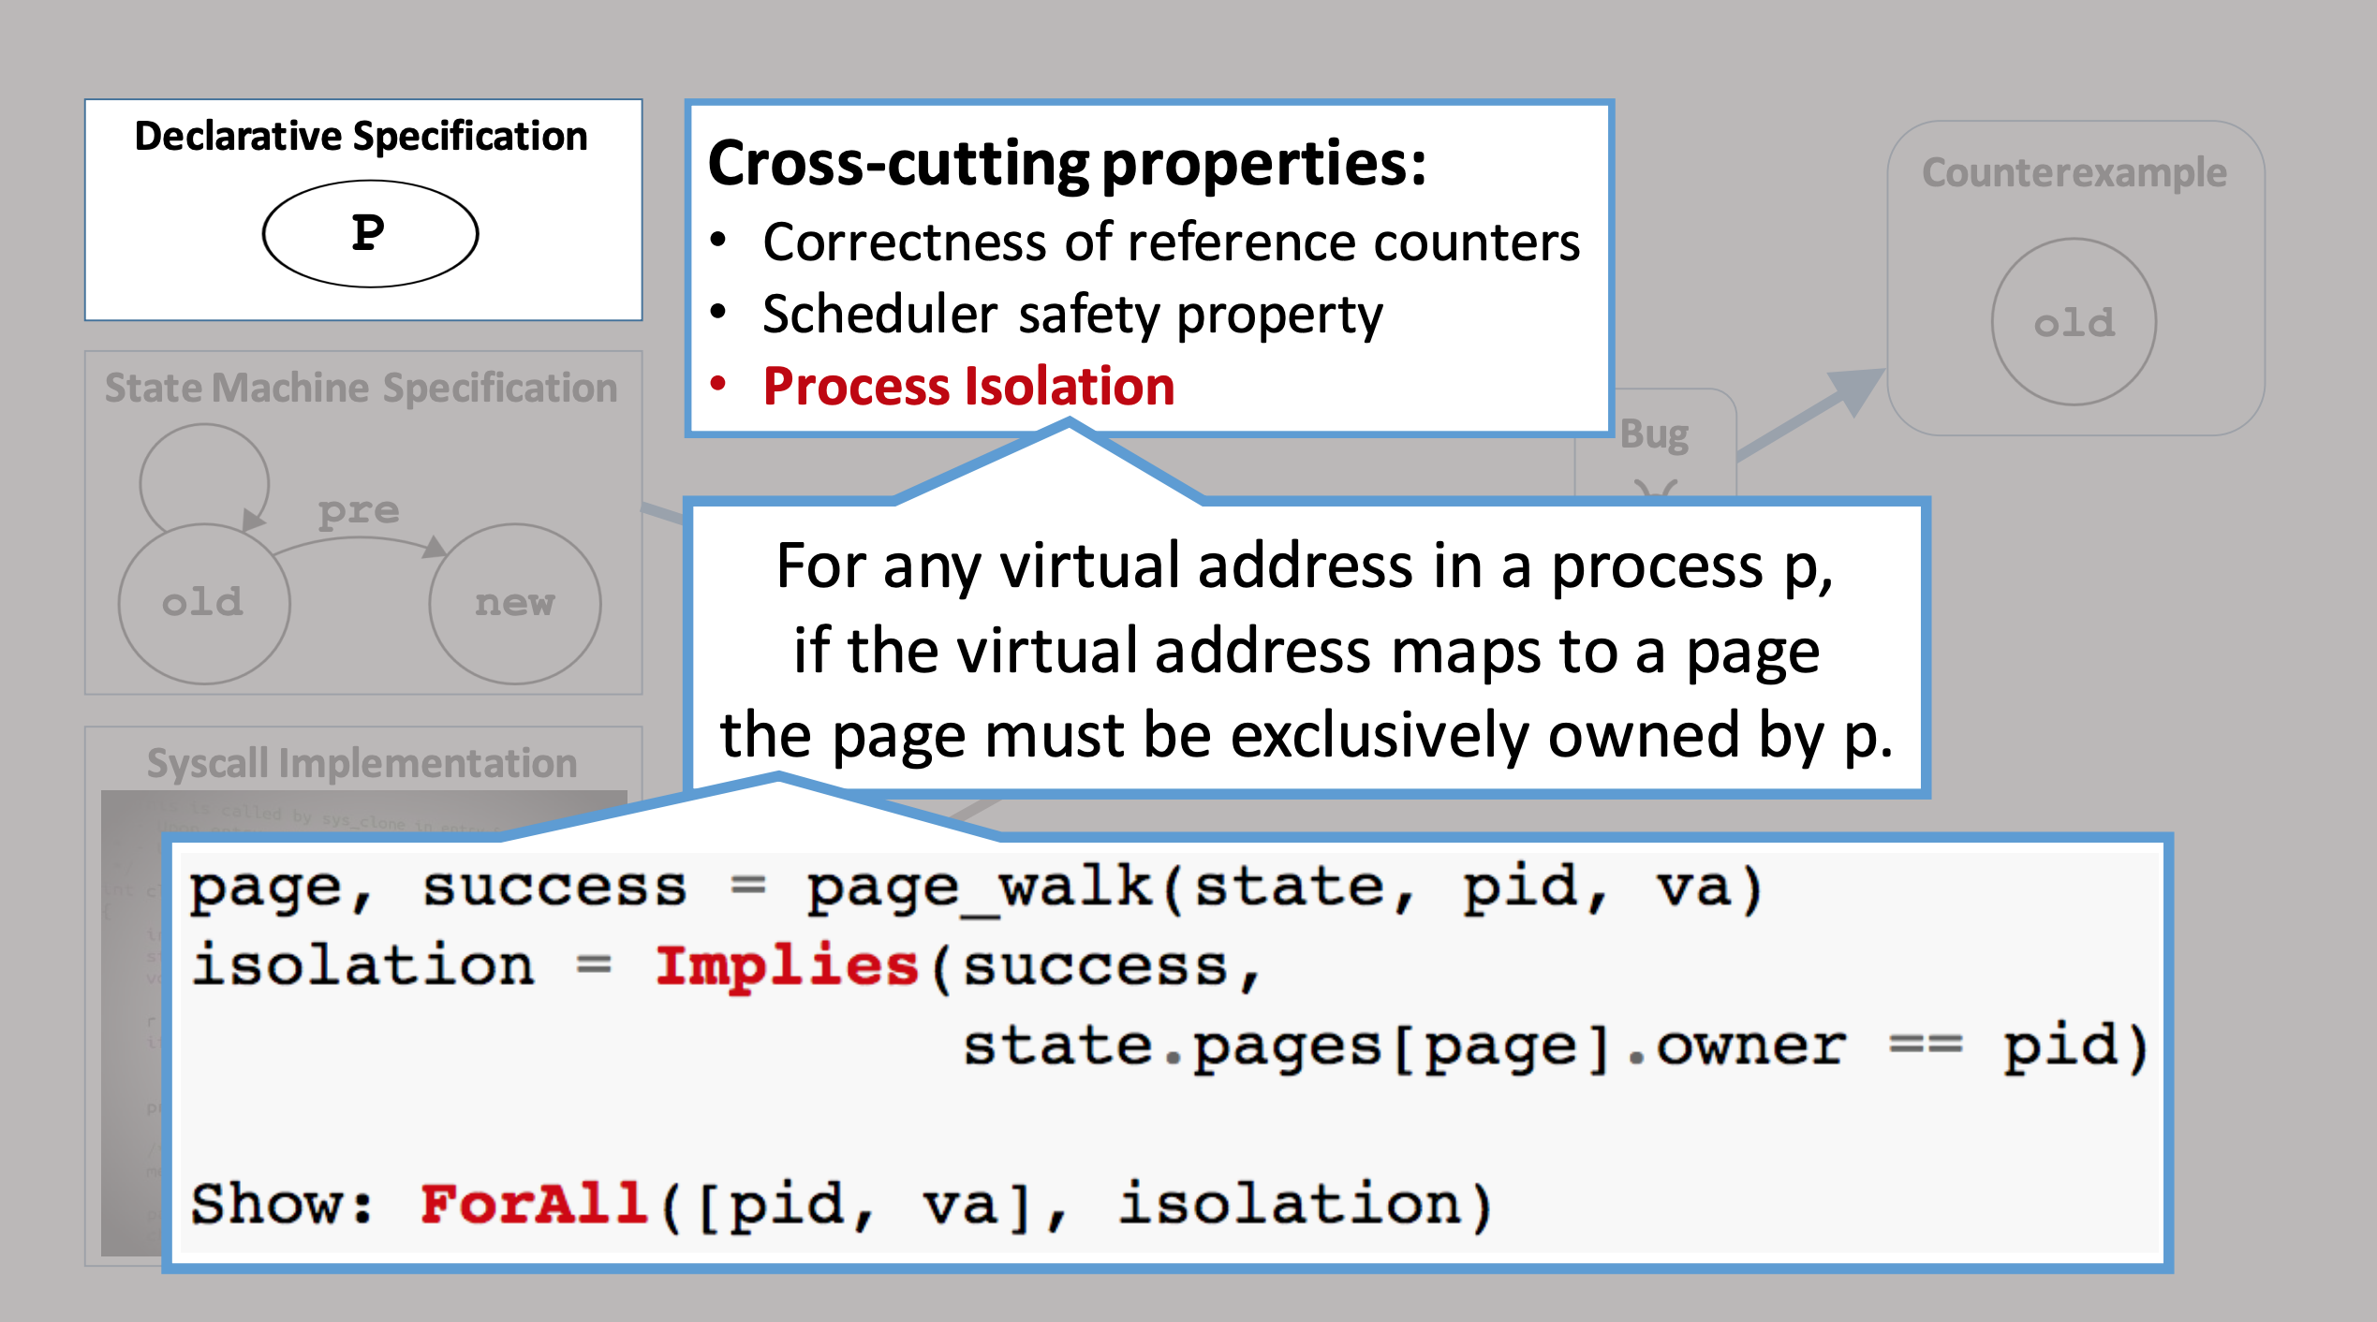

Slide 67
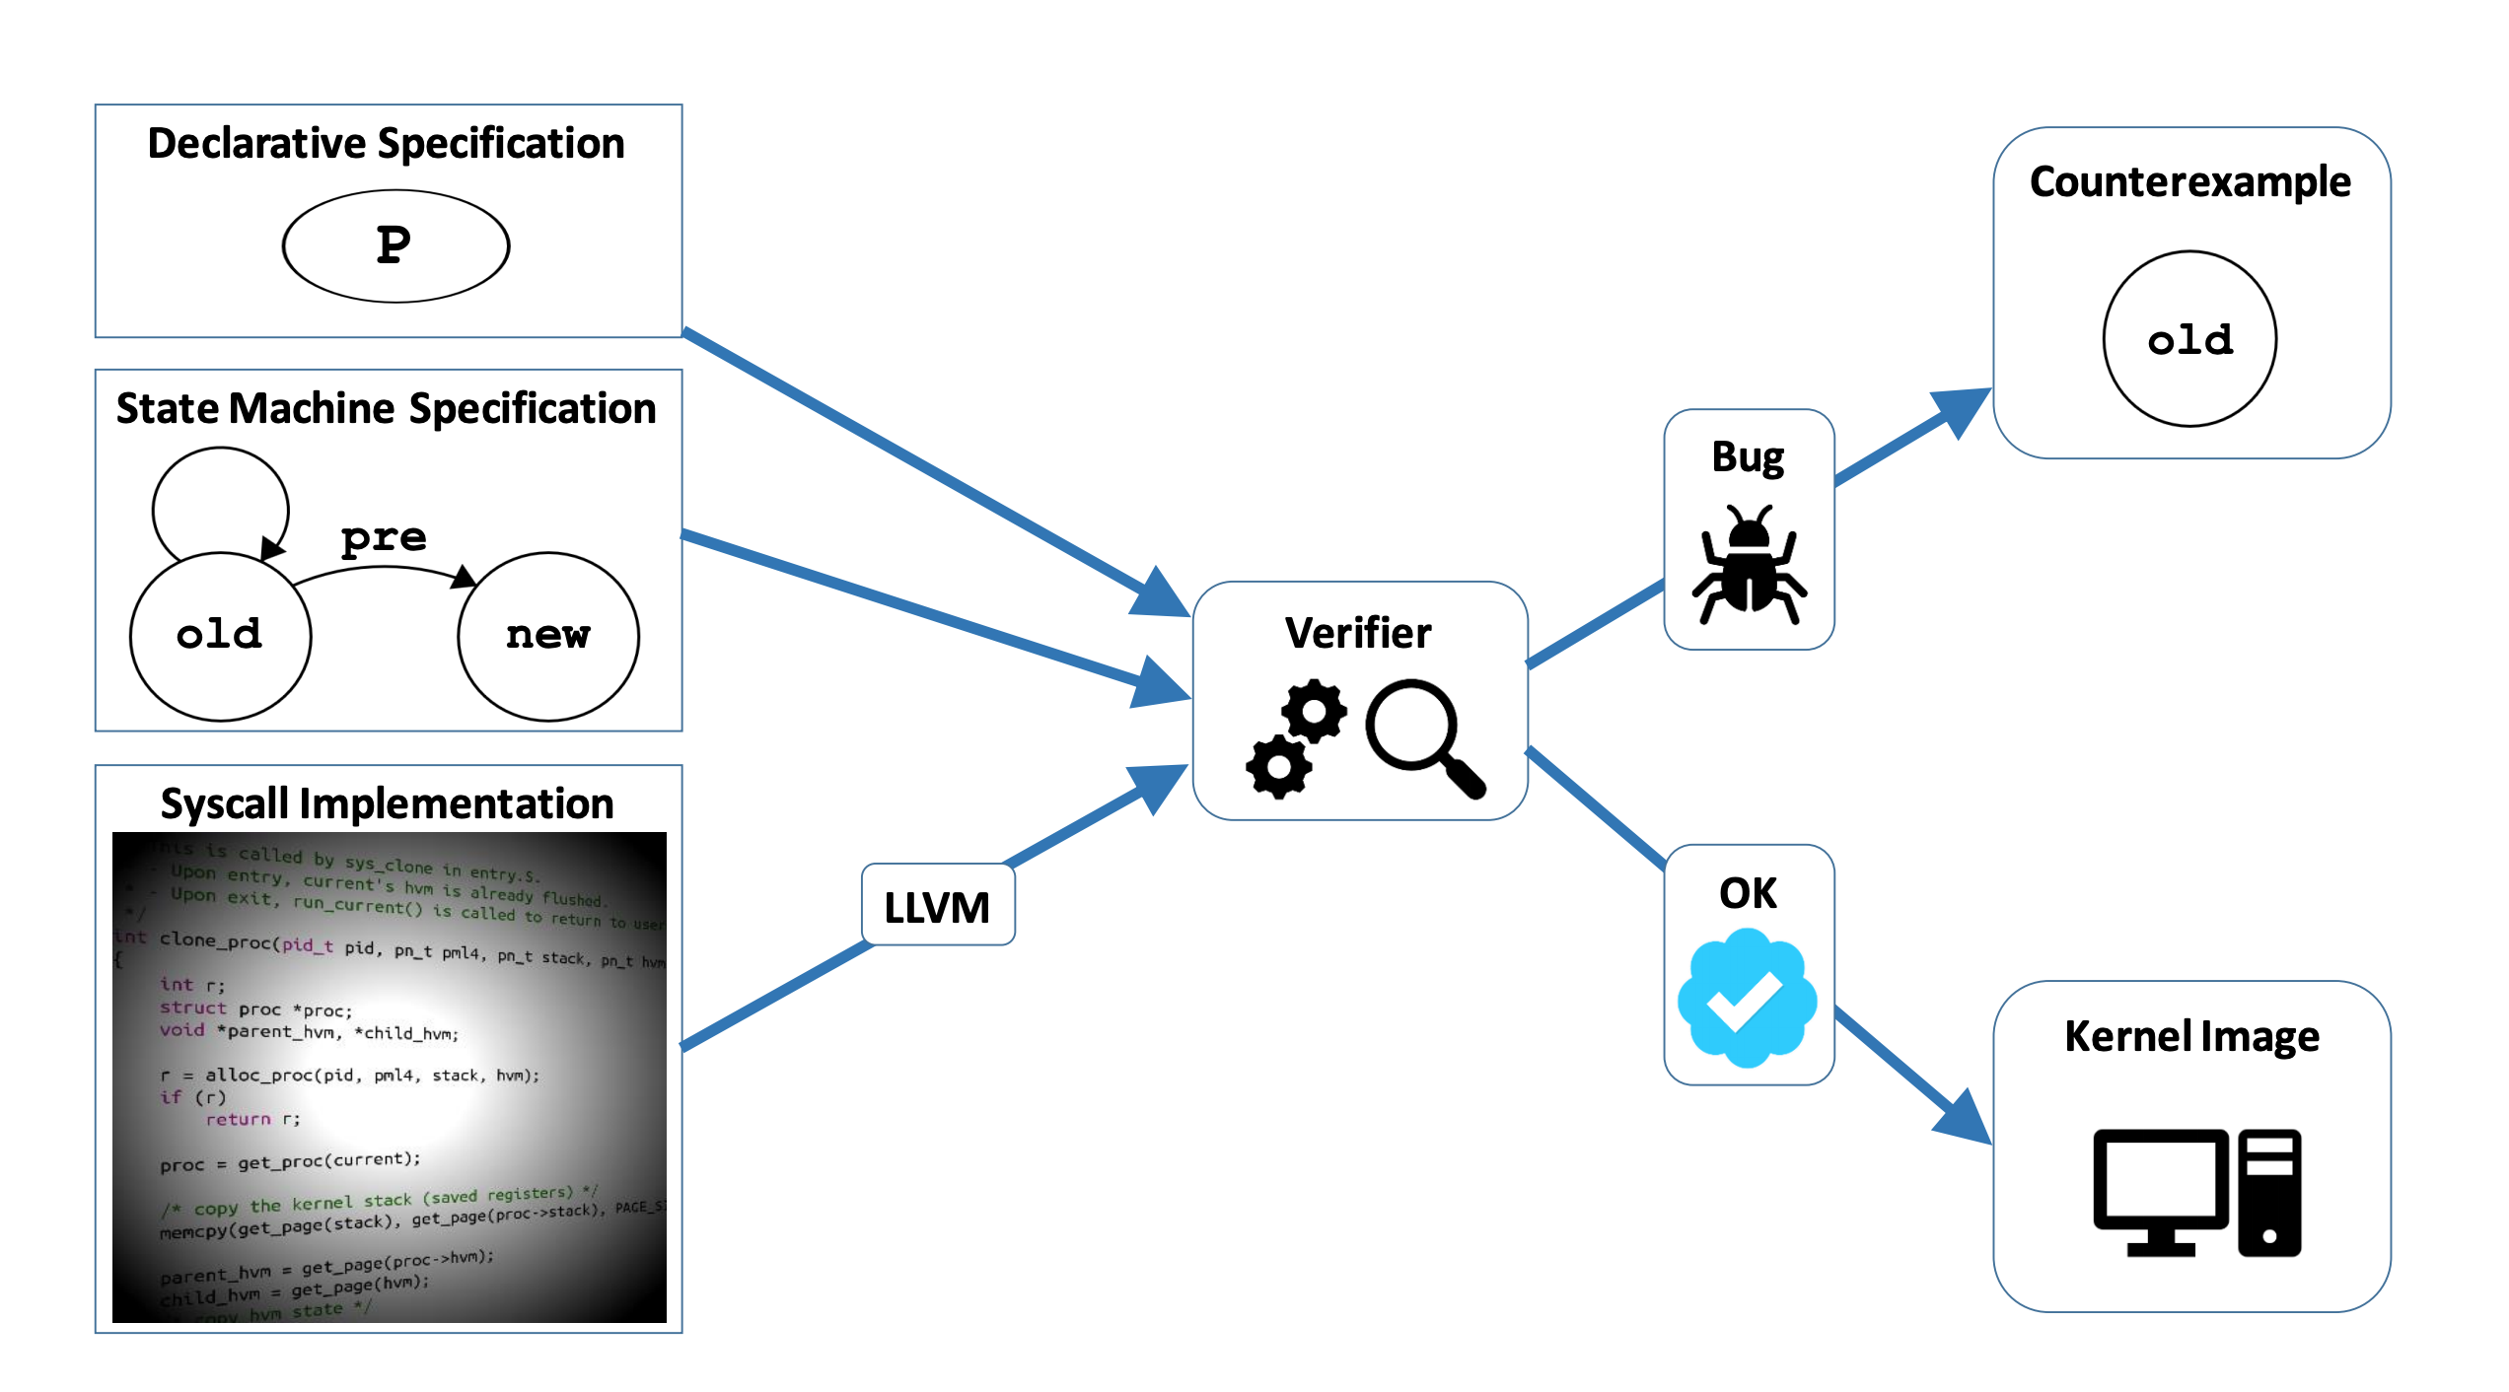
If the verifier succeeds, a kernel image is produced!
Does not require user proofs or code annotations!

Slide 68
Wait…what’s the catch?
Automatically verifying a full, “normal” kernel would be too-good-to-be-true
Limitations
Only so much complexity can be expressed in syscall state machine specification
Verification based on SMT solver, so complex implementations are computationally infeasible to verify
Addressing these limitations has a significant impact on kernel design!

Slide 69
Hyperkernel introduces “finite” system call interfaces
No in-kernel loops → move to userspace
Kernel only has to validate, not search! Sound familiar?
Decompose system calls
Make each implementation simpler
What is the tradeoff?

Slide 70
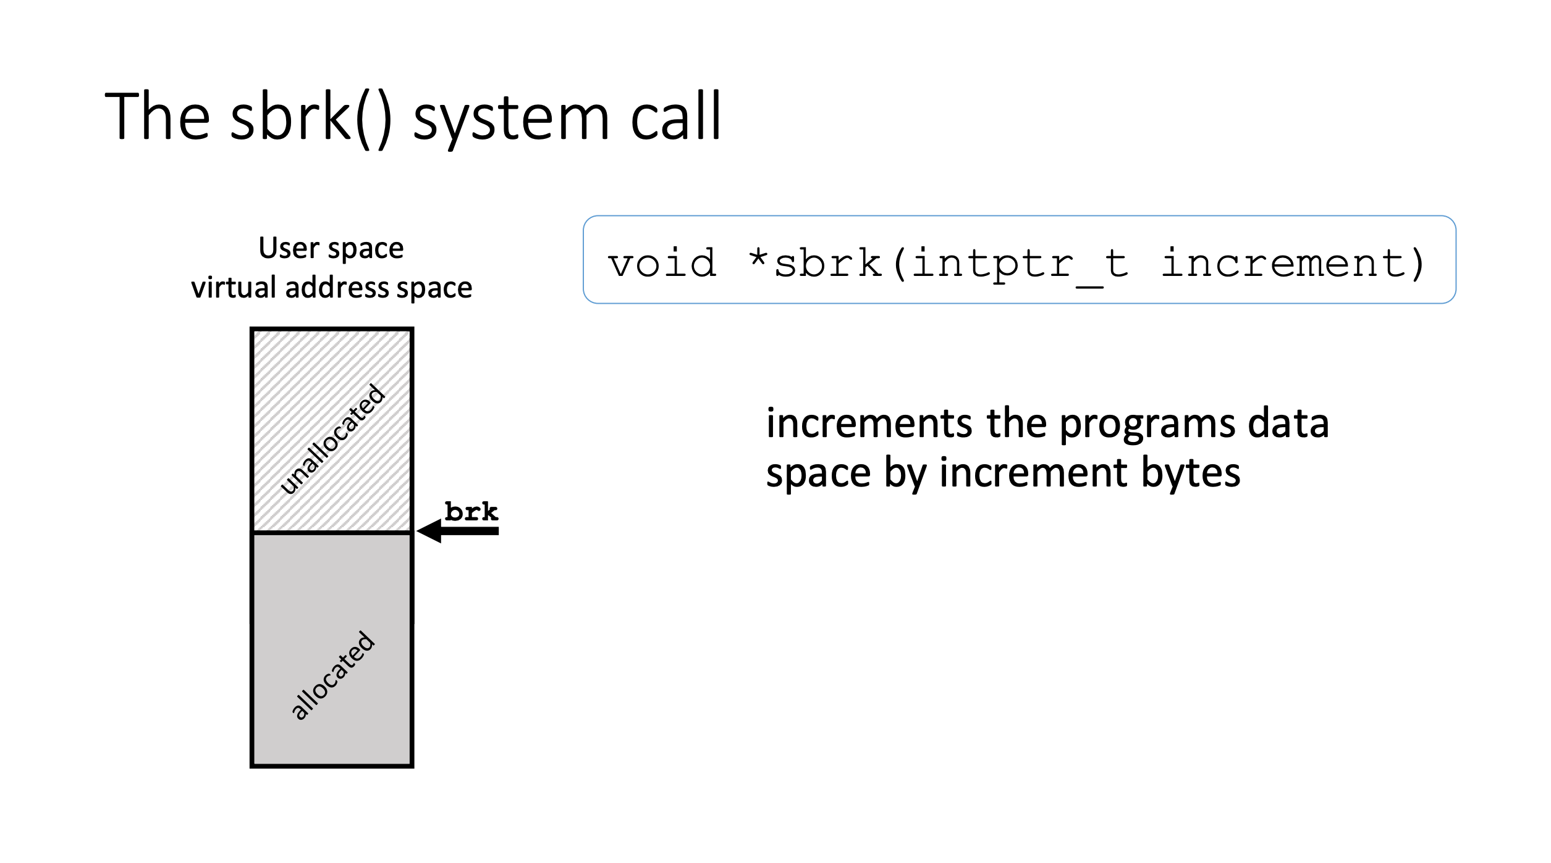
Example

Slide 71
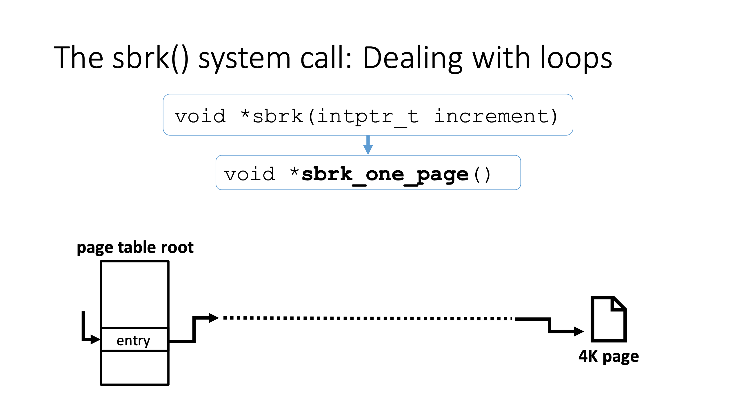
Now, much more concrete what the kernel must do!
But, how simple is allocating a single page?

Slide 72
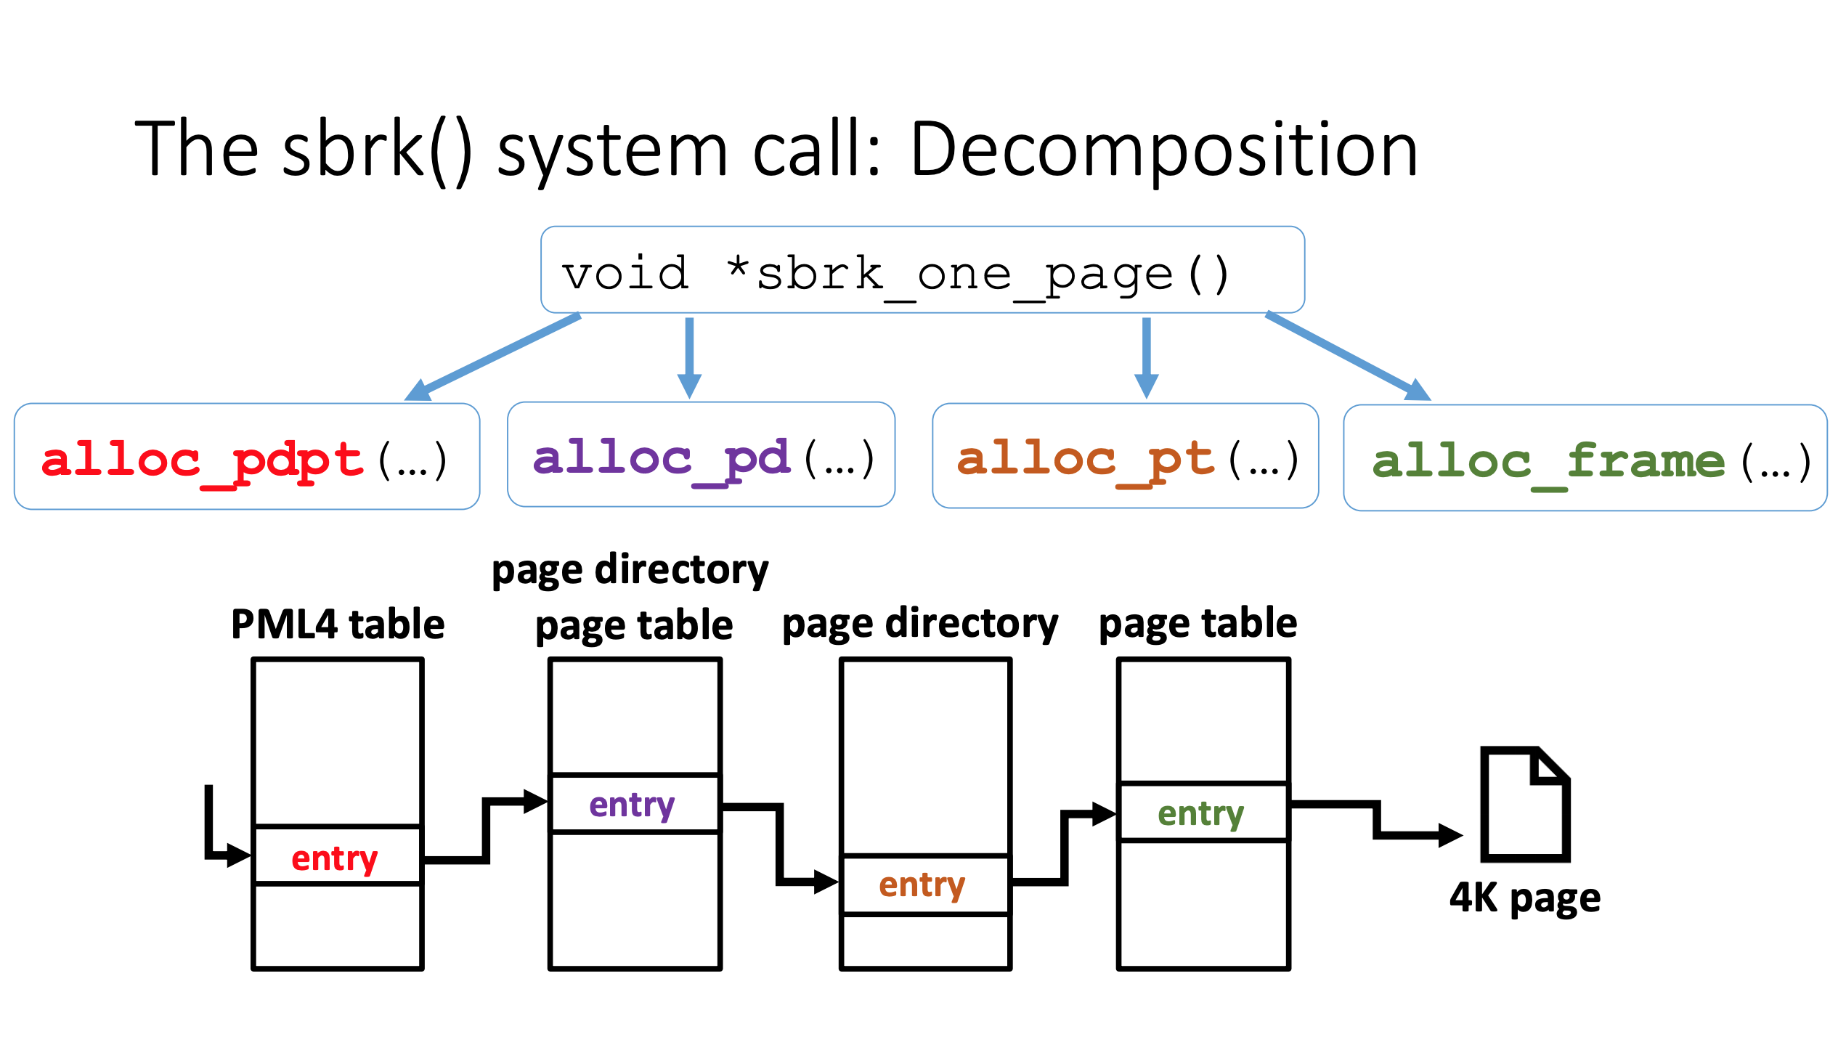
Nested tables may make this quite complex, so separate out tasks into separate syscalls.

Slide 73
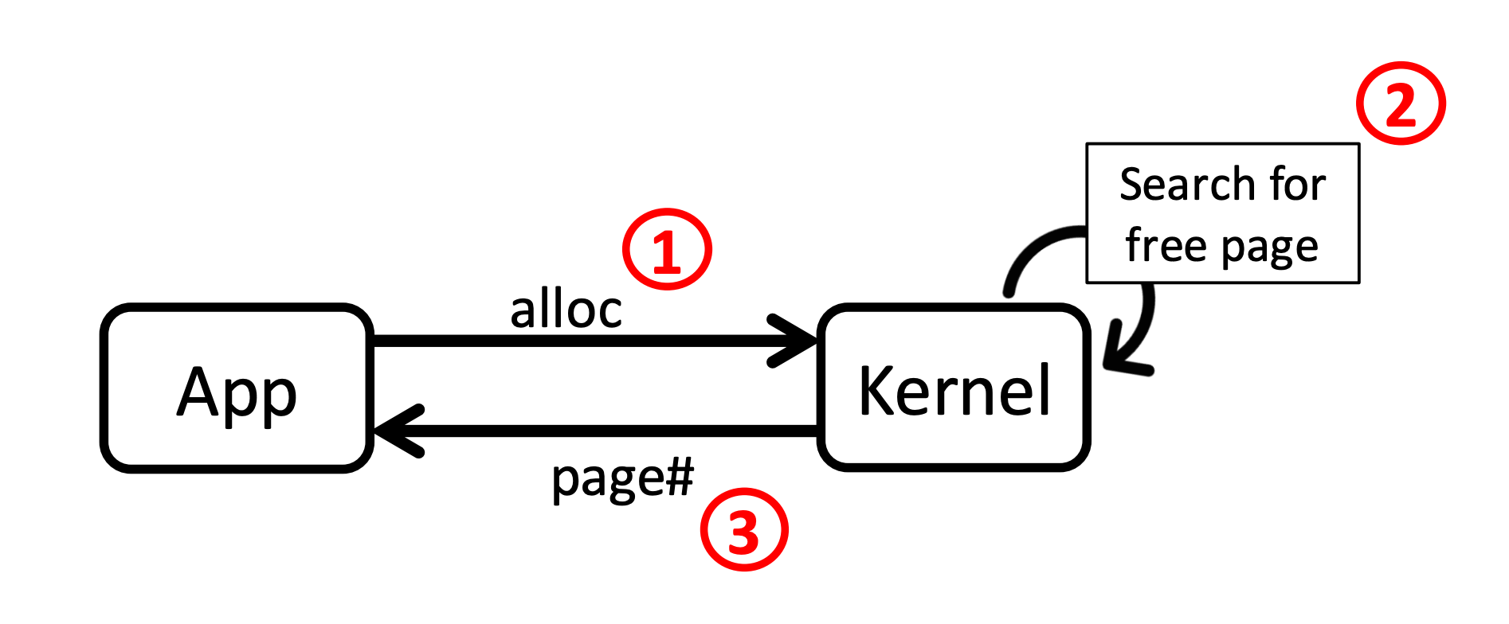
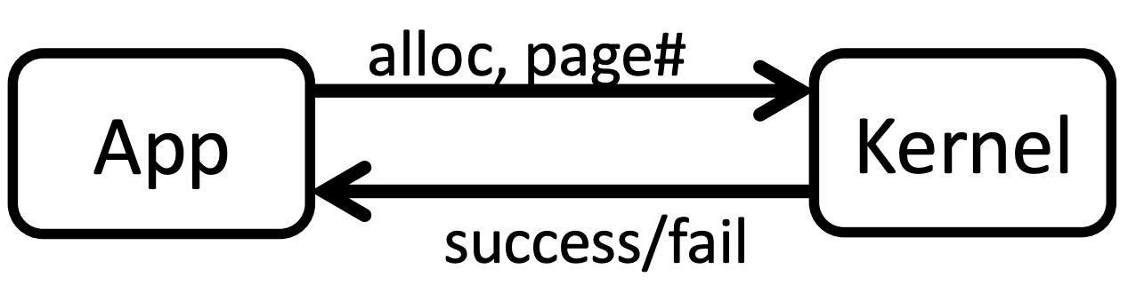
One more problem…
Finding a free page, even a single one, is likely a looping operation.
Instead, make userspace do the search, and only validate in kernel.

Slide 74
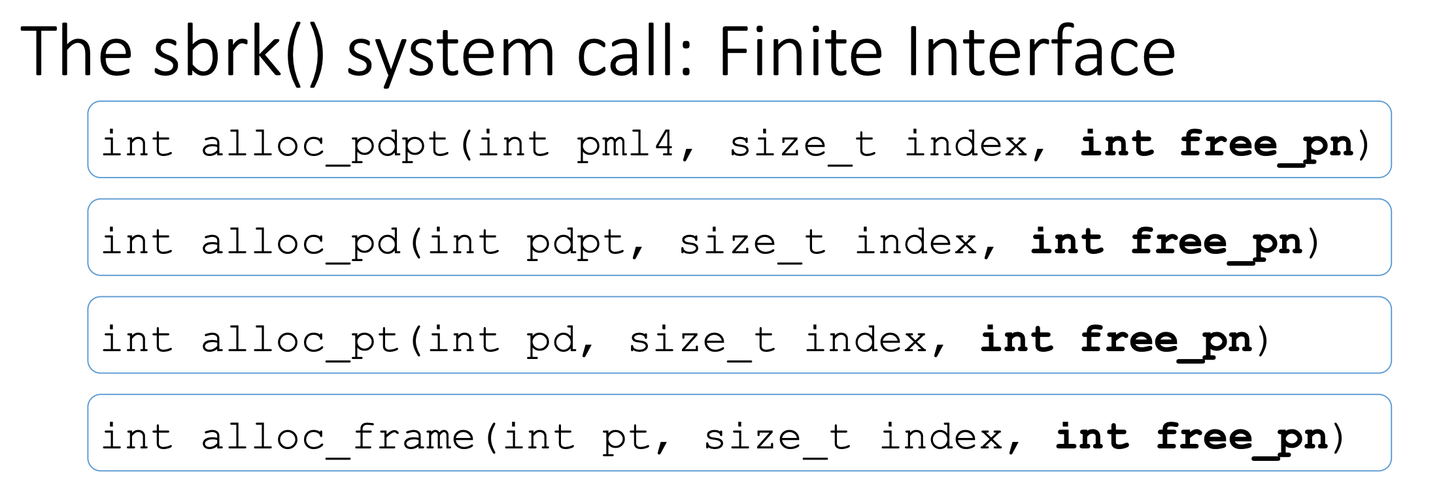

Slide 75
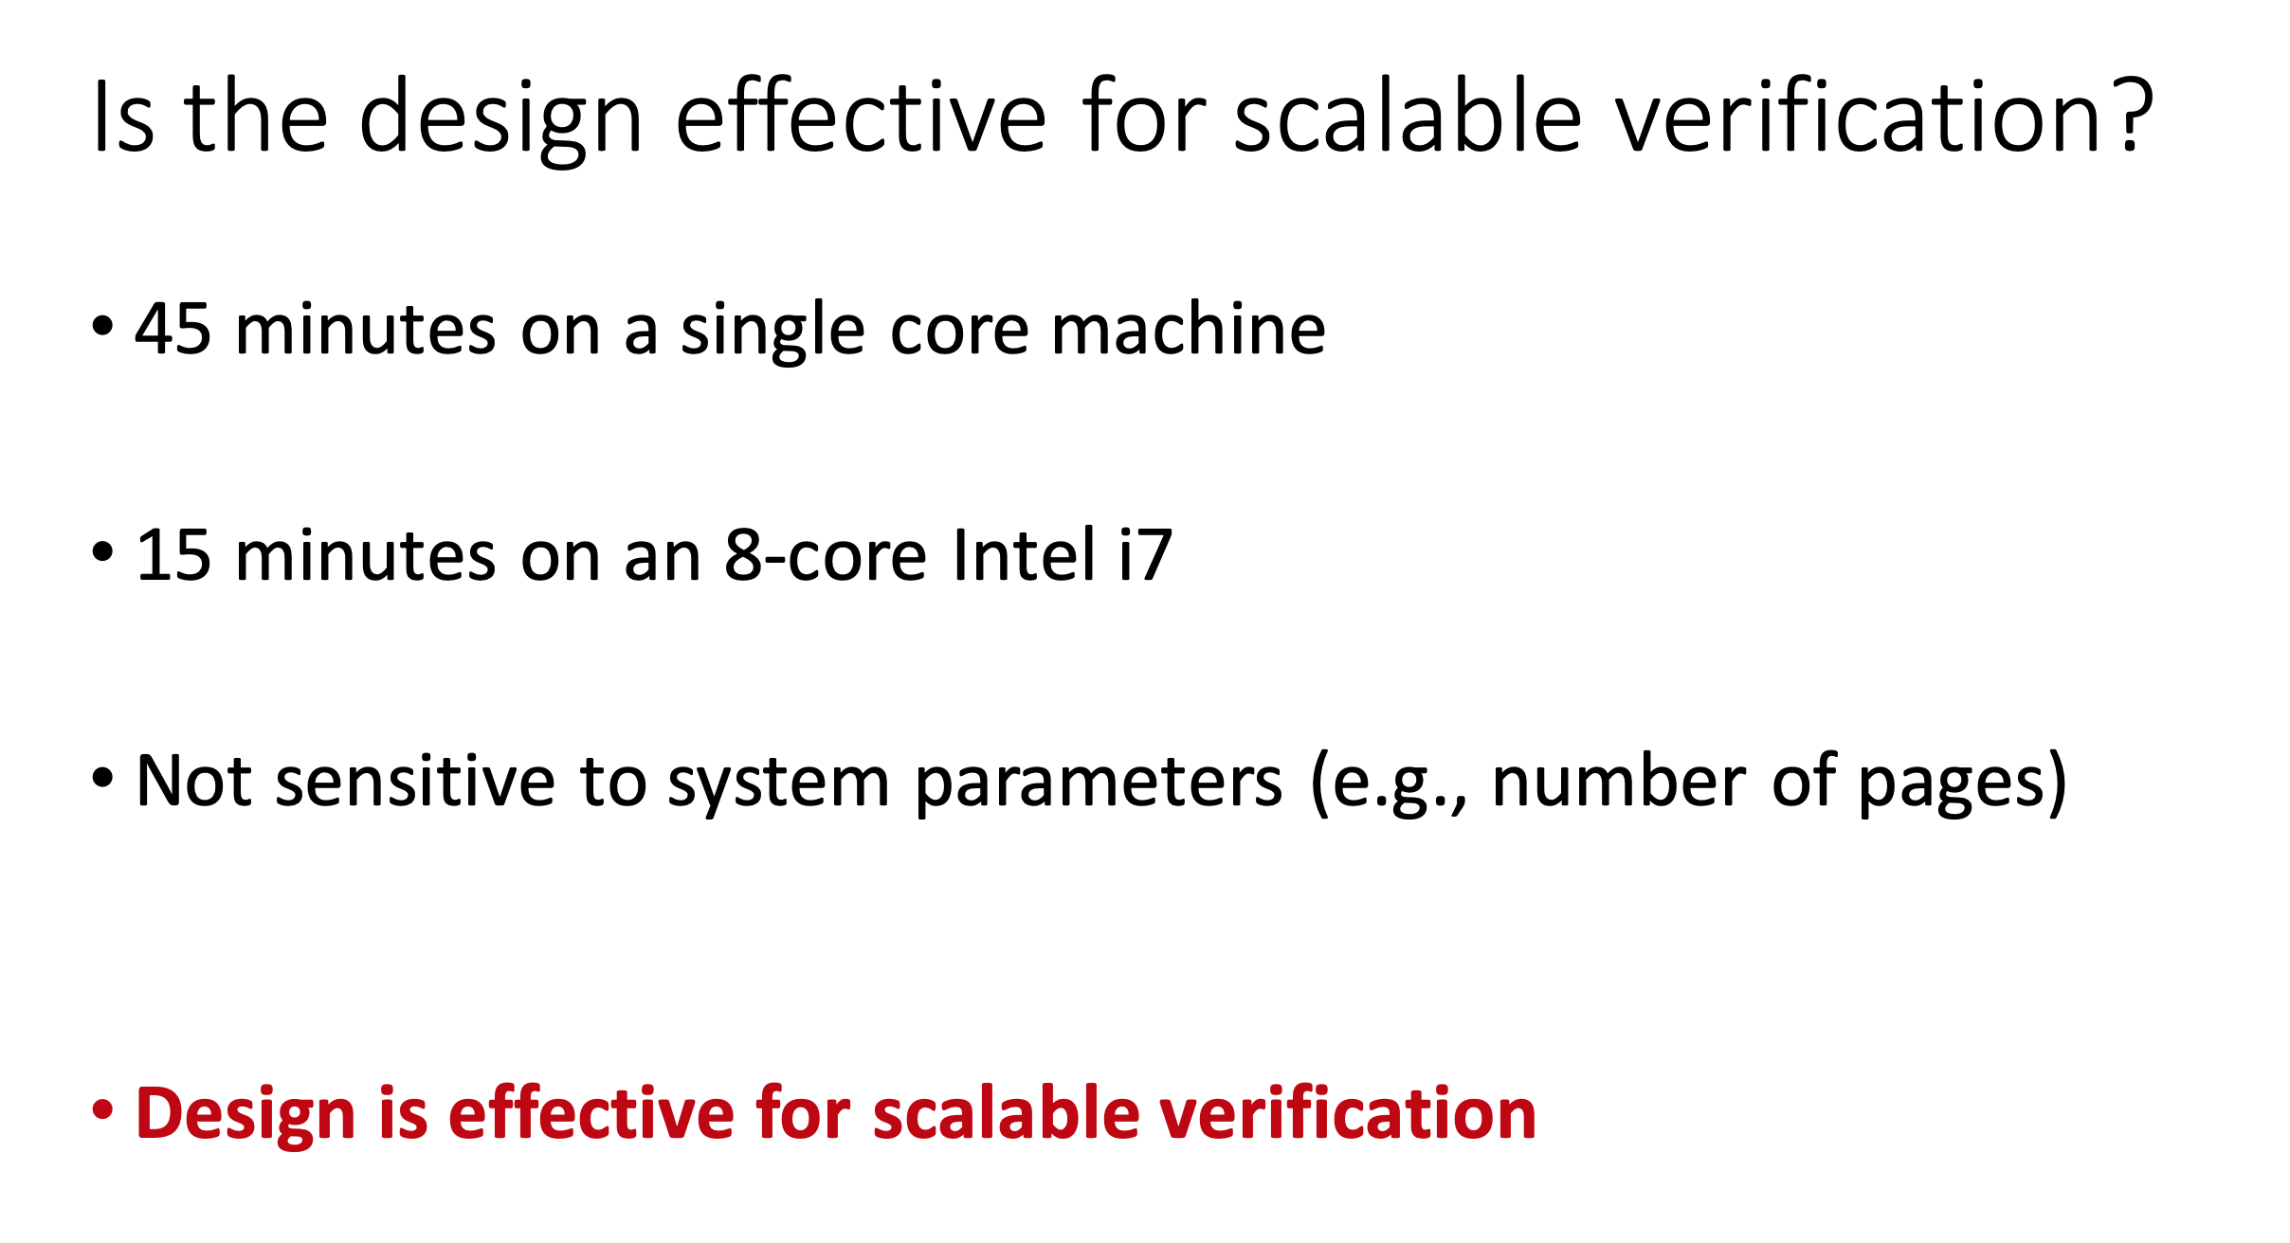

Slide 76
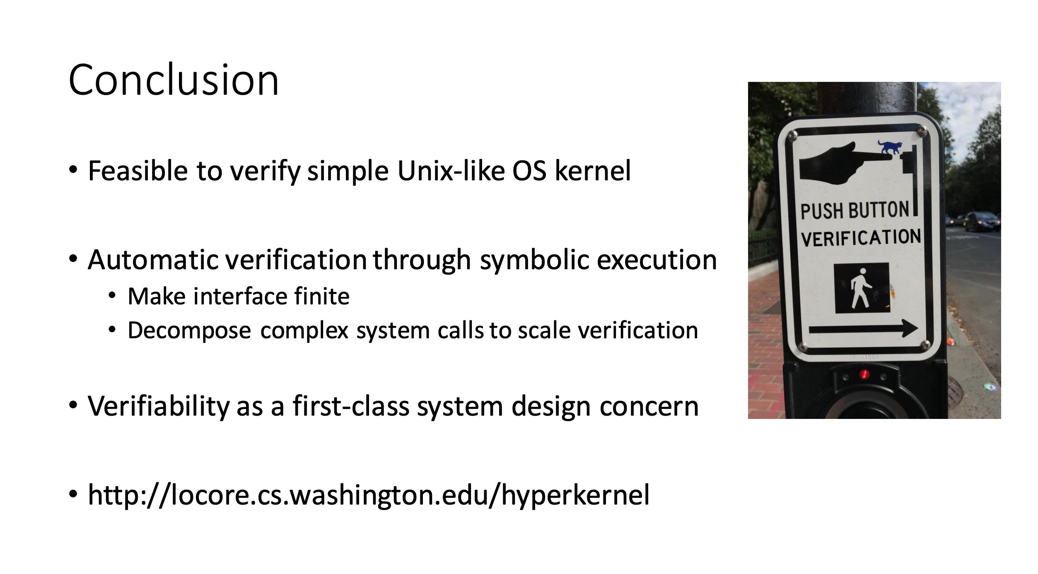

Slide 77
Security

Slide 78
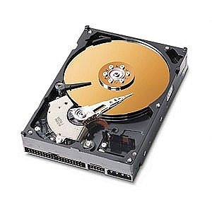
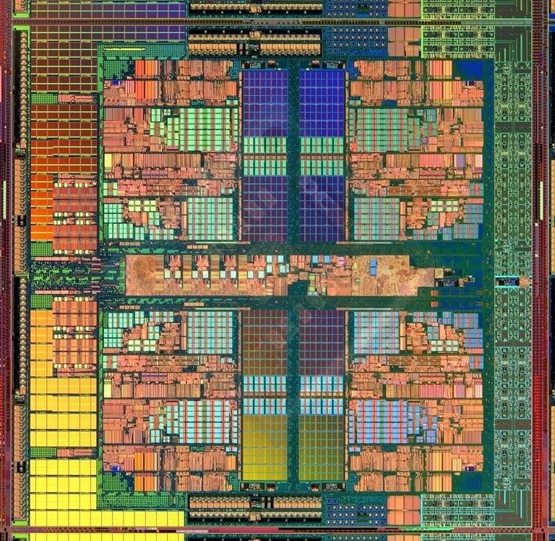
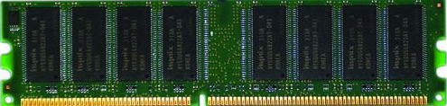
The Main Memory System
Main memory is a critical component of all computing systems: server, mobile, embedded, desktop, sensor
Main memory system must scale (in size, technology, efficiency, cost, and management algorithms) to maintain performance growth and technology scaling benefits
Processor
and caches
Main Memory
Storage (SSD/HDD)

Slide 79
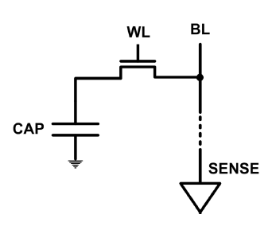
The DRAM Scaling Problem
DRAM stores charge in a capacitor (charge-based memory)
Capacitor must be large enough for reliable sensing
Access transistor should be large enough for low leakage and high retention time
Scaling beyond 40-35nm (2013) is challenging [ITRS, 2009]
As DRAM cell becomes smaller, it becomes more vulnerable

Slide 80
Security Example from Hardware
What is Rowhammer?
Levels of defenses
Probabalistic
Detect and React
Protect everything!
What is the “right” level of protection?

Slide 81
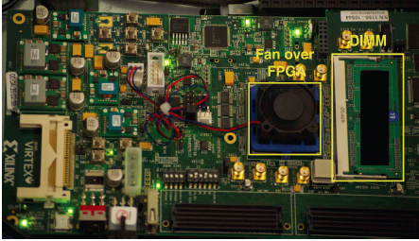
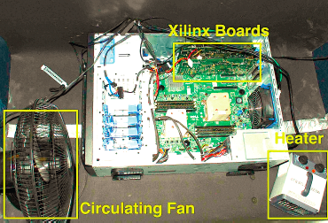
Testing DRAM Scaling Issues …
An Experimental Study of Data Retention Behavior in Modern DRAM Devices: Implications for Retention Time Profiling Mechanisms (Liu et al., ISCA 2013)
The Efficacy of Error Mitigation Techniques for DRAM Retention Failures: A Comparative Experimental Study
(Khan et al., SIGMETRICS 2014)
Flipping Bits in Memory Without Accessing Them: An Experimental Study of DRAM Disturbance Errors (Kim et al., ISCA 2014)
Adaptive-Latency DRAM: Optimizing DRAM Timing for the Common-Case (Lee et al., HPCA 2015)
AVATAR: A Variable-Retention-Time (VRT) Aware Refresh for DRAM Systems (Qureshi et al., DSN 2015)

Slide 82
Modern DRAM is Prone to Disturbance Errors
Row of Cells
Wordline
Row
Victim Row
Row
Hammered Row
V_{LOW}
Opened
V_{HIGH}
Closed
Row
Victim Row
Row
Repeatedly opening and closing a row enough times within a refresh interval induces disturbance errors in adjacent rows in most real DRAM chips you can buy today
Flipping Bits in Memory Without Accessing Them: An Experimental Study of DRAM Disturbance Errors, (Kim et al., ISCA 2014)

Slide 83

Threat overview
DRAM Bank
Process 1
Process n
…
Linux
OS State
Processor
Corrupt
…
Notes:
Finally we present a robust a software-based rowhammering attack mitigation technique, ANVIL. Anvil detects rowhammering attacks by monitoring cache misses out of the LLC using existing performance counter features. Up

Slide 84
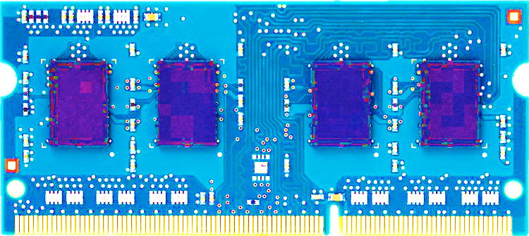
Most DRAM Modules Are Vulnerable
A company
B company
C company
86%
(37/43)
83%
(45/54)
88%
(28/32)
Up to
1.0×10⁷ errors
Up to
2.7×10⁶ errors
Up to
3.3×10⁵ errors
Flipping Bits in Memory Without Accessing Them: An Experimental Study of DRAM Disturbance Errors, (Kim et al., ISCA 2014)

Slide 85
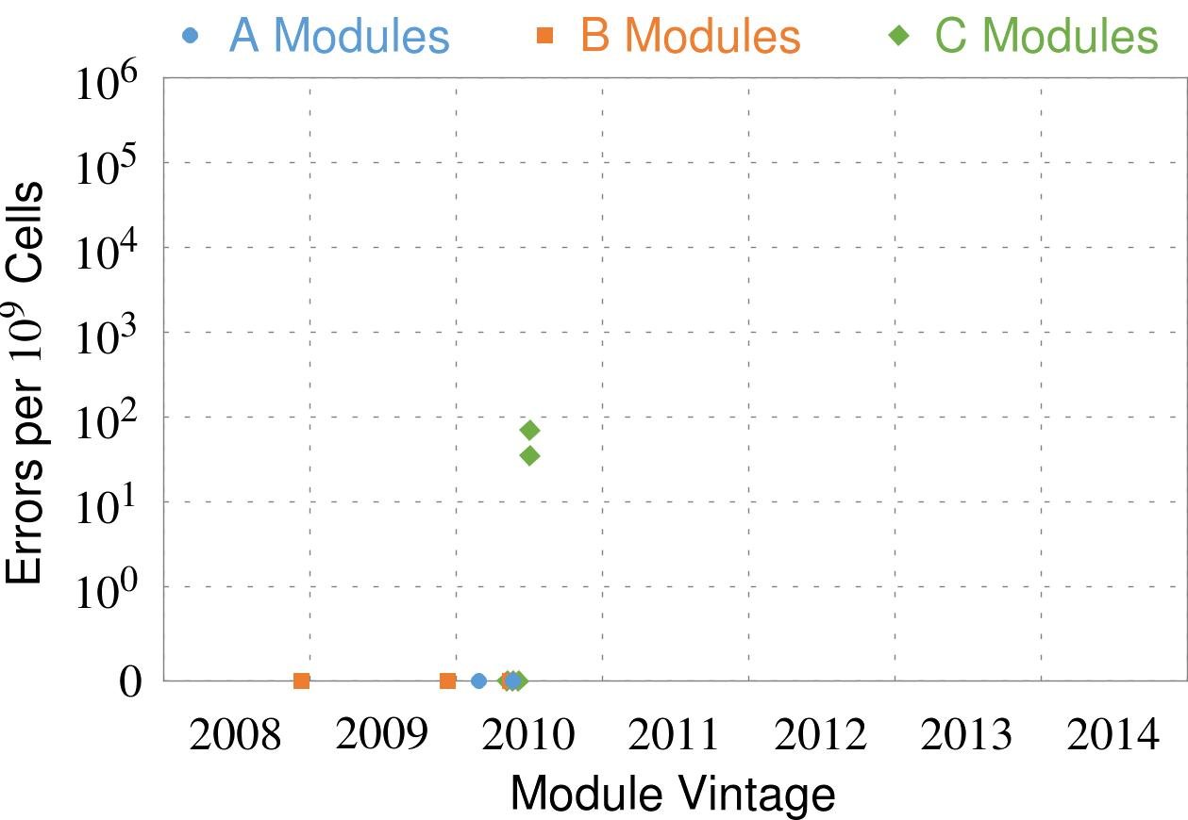
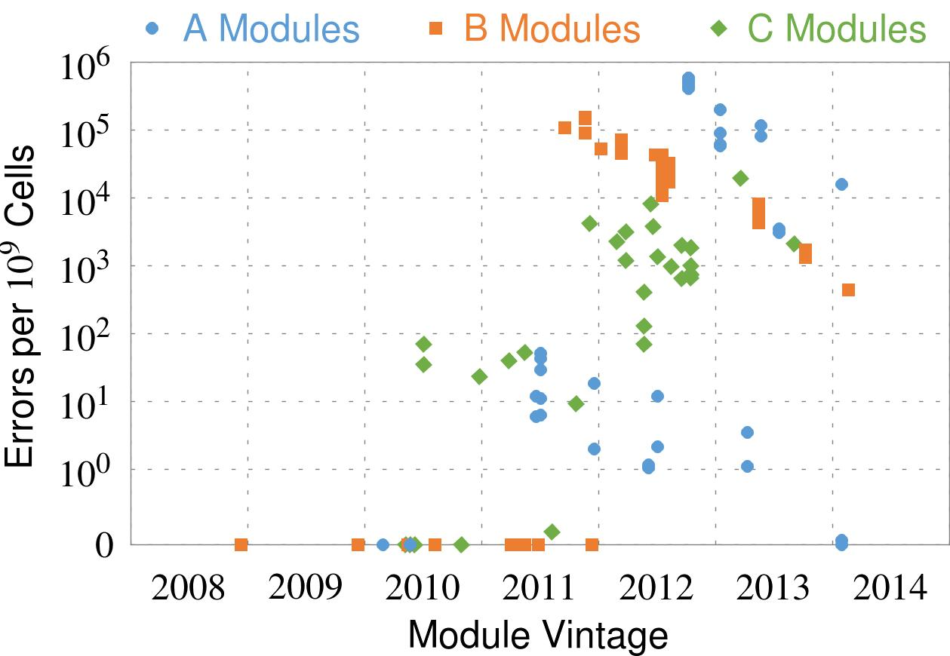
Recent DRAM Is More Vulnerable
First
Appearance
All modules from 2012–2013 are vulnerable
Notes:
In this figure, the x-axis is the module manufacture date. And the y-axis is the number of errors in a module, normalized to one billion cells. In 2008 and 2009, there are no errors. But, in 2010, we first start to see errors in C modules. After 2010, the errors start to proliferate. For A and B modules, we first start to see errors in 2011. In particular, all modules from 2012 and 2013 are vulnerable.

Slide 86
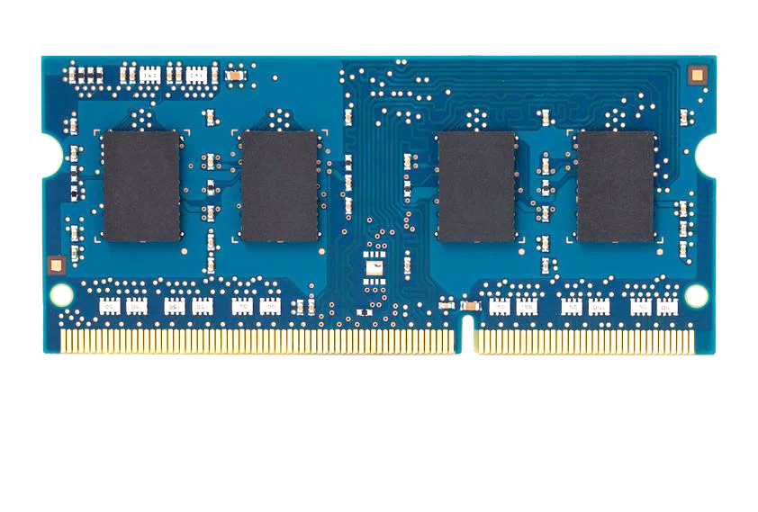
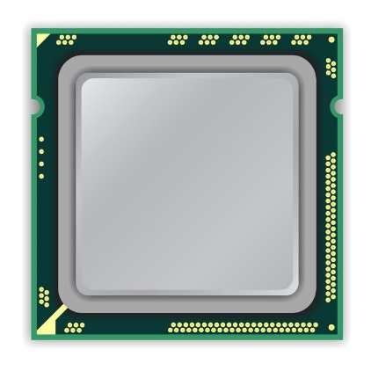
A Simple Program Can Induce Many Errors
CPU
DRAM Module
loop:
mov (X), %eax
mov (Y), %ebx
clflush (X)
clflush (Y)
mfence
jmp loop
X
Y
Download from: https://github.com/CMU-SAFARI/rowhammer
Notes:
We demonstrate the errors on multiple x86 systems. Shown to the bottom-left is a “disturbance kernel”. When executed, it forces two rows to be opened and closed one after the other – over and over again. Consequently, it induces many errors in the module.

Slide 87
A Simple Program Can Induce Many Errors
CPU
DRAM Module
Avoid cache hits
Flush X from cache
Avoid row hits to X
Read Y in another row
X
Y
Download from: https://github.com/CMU-SAFARI/rowhammer
Notes:
We demonstrate the errors on multiple x86 systems. Shown to the bottom-left is a “disturbance kernel”. When executed, it forces two rows to be opened and closed one after the other – over and over again. Consequently, it induces many errors in the module.

Slide 88
A Simple Program Can Induce Many Errors
CPU
DRAM Module
loop:
mov (X), %eax
mov (Y), %ebx
clflush (X)
clflush (Y)
mfence
jmp loop
X
Y
Download from: https://github.com/CMU-SAFARI/rowhammer
Notes:
We demonstrate the errors on multiple x86 systems. Shown to the bottom-left is a “disturbance kernel”. When executed, it forces two rows to be opened and closed one after the other – over and over again. Consequently, it induces many errors in the module.

Slide 89
A Simple Program Can Induce Many Errors
CPU
DRAM Module
loop:
mov (X), %eax
mov (Y), %ebx
clflush (X)
clflush (Y)
mfence
jmp loop
X
Y
Download from: https://github.com/CMU-SAFARI/rowhammer
Notes:
We demonstrate the errors on multiple x86 systems. Shown to the bottom-left is a “disturbance kernel”. When executed, it forces two rows to be opened and closed one after the other – over and over again. Consequently, it induces many errors in the module.

Slide 90
A Simple Program Can Induce Many Errors
CPU
DRAM Module
loop:
mov (X), %eax
mov (Y), %ebx
clflush (X)
clflush (Y)
mfence
jmp loop
X
Y
Download from: https://github.com/CMU-SAFARI/rowhammer
Notes:
We demonstrate the errors on multiple x86 systems. Shown to the bottom-left is a “disturbance kernel”. When executed, it forces two rows to be opened and closed one after the other – over and over again. Consequently, it induces many errors in the module.

Slide 91
Observed Errors in Real Systems
A real reliability & security issue
In a more controlled environment, we can induce as many as ten million disturbance errors
CPU Architecture | Errors | Access-Rate
Intel Haswell (2013) | 22.9K | 12.3M/sec
Intel Ivy Bridge (2012) | 20.7K | 11.7M/sec
Intel Sandy Bridge (2011) | 16.1K | 11.6M/sec
AMD Piledriver (2012) | 59 | 6.1M/sec
Kim+, “Flipping Bits in Memory Without Accessing Them: An Experimental Study of DRAM Disturbance Errors,” ISCA 2014.
Notes:
When we executed the code on four different processors, all four of them yielded errors. Intel Haswell has the most errors, at 23 thousand, because it has the highest rate of accessing DRAM.
Later on, I’ll show that we can induce as many as ten million disturbance errors in a more controlled environment.
From this, we conclude that disturbance errors are a serious reliability issue.

Slide 92
RowHammer Security Attack Example
“Rowhammer” is a problem with some recent DRAM devices in which repeatedly accessing a row of memory can cause bit flips in adjacent rows (Kim et al., ISCA 2014).
Flipping Bits in Memory Without Accessing Them: An Experimental Study of DRAM Disturbance Errors (Kim et al., ISCA 2014)
We tested a selection of laptops and found that a subset of them exhibited the problem.
We built two working privilege escalation exploits that use this effect.
Exploiting the DRAM rowhammer bug to gain kernel privileges (Seaborn, 2015)
One exploit uses rowhammer-induced bit flips to gain kernel privileges on x86-64 Linux when run as an unprivileged userland process.
When run on a machine vulnerable to the rowhammer problem, the process was able to induce bit flips in page table entries (PTEs).
It was able to use this to gain write access to its own page table, and hence gain read-write access to all of physical memory.
Exploiting the DRAM rowhammer bug to gain kernel privileges (Seaborn, 2015)

Slide 93
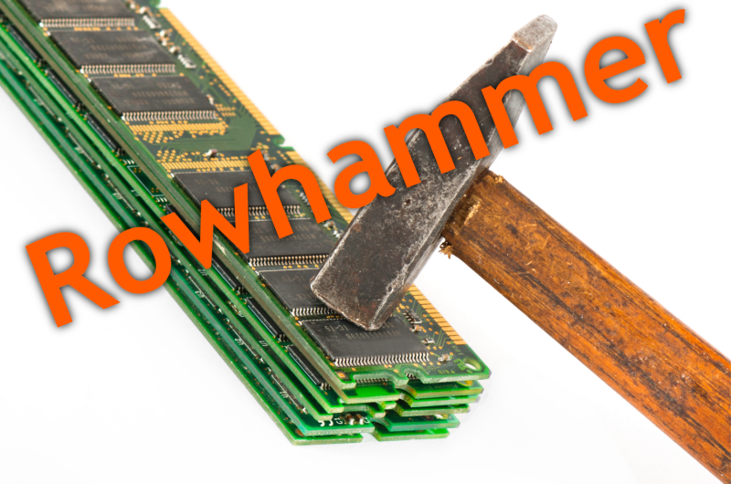
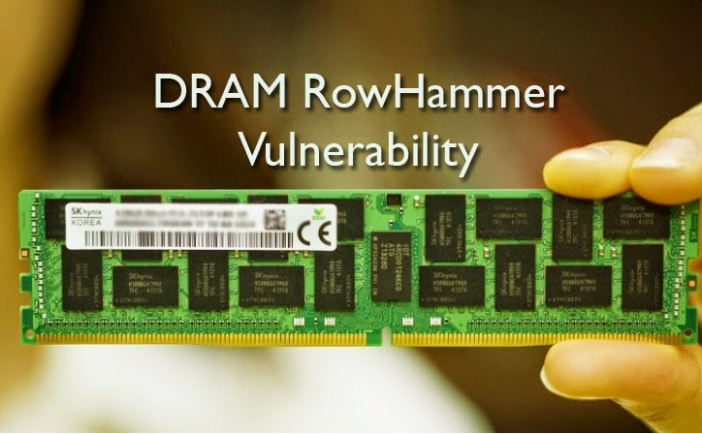
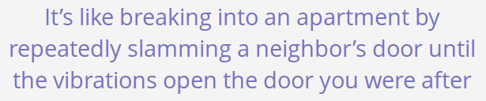
Security Implications
Notes:
Picture from the article:
http://thehackernews.com/2015/03/dram-rowhammer-vulnerability.html

Slide 94
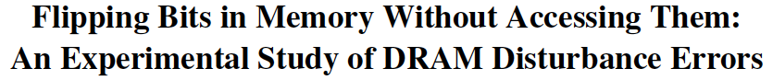
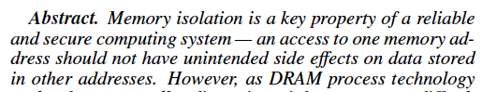
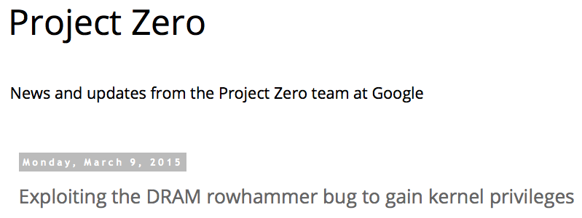
One Can Take Over an Otherwise-Secure System
Flipping Bits in Memory Without Accessing Them: An Experimental Study of DRAM Disturbance Errors (Kim et al., ISCA 2014)
Exploiting the DRAM rowhammer bug to gain kernel privileges (Seaborn, 2015)

Slide 95
Root Causes of Disturbance Errors
Cause 1: Electromagnetic coupling
Toggling the wordline voltage briefly increases the voltage of adjacent wordlines
Slightly opens adjacent rows → Charge leakage
Cause 2: Conductive bridges
Cause 3: Hot-carrier injection
Confirmed by at least one manufacturer
Notes:
Why do the errors occur? We see three possible causes.
First, there could electromagnetic coupling between adjacent wordlines. When the voltage of one is toggled, it could briefly increase the voltage of the other and facilitate the leakage of charge.
Two other possibilities are conductive bridges and hot-carrier injection.
At least one manufacturer confirmed that these three could play a role in the disturbance errors we see them today.

Slide 96
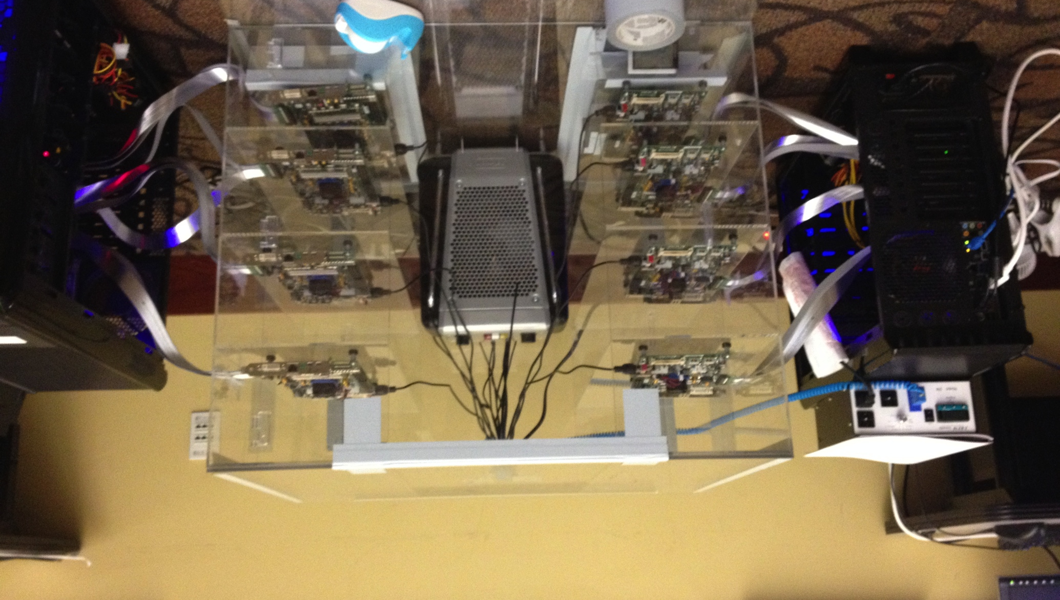
Experimental DRAM Testing Infrastructure
Temperature
Controller
FPGAs
Heater
FPGAs
PC
Kim+, “Flipping Bits in Memory Without Accessing Them: An Experimental Study of DRAM Disturbance Errors,” ISCA 2014.

Slide 97
RowHammer Characterization Results
Most Modules Are at Risk
Errors vs. Vintage
Error = Charge Loss
Adjacency: Aggressor & Victim
Sensitivity Studies
Other Results in Paper
Solution Space
Flipping Bits in Memory Without Accessing Them: An Experimental Study of DRAM Disturbance Errors, (Kim et al., ISCA 2014)
Notes:
Now I will present the characterization results, one-by-one.
First, I show that most modules are at risk. Second, I show the number of errors in a module as a function of the manufacture date. Third, I show that the errors are symptomatic of charge loss. Fourth, I show that an aggressor induces errors in adjacent rows. Fifth, I show several sensitivity studies. And, finally, I briefly describe other results in the paper.

Slide 98
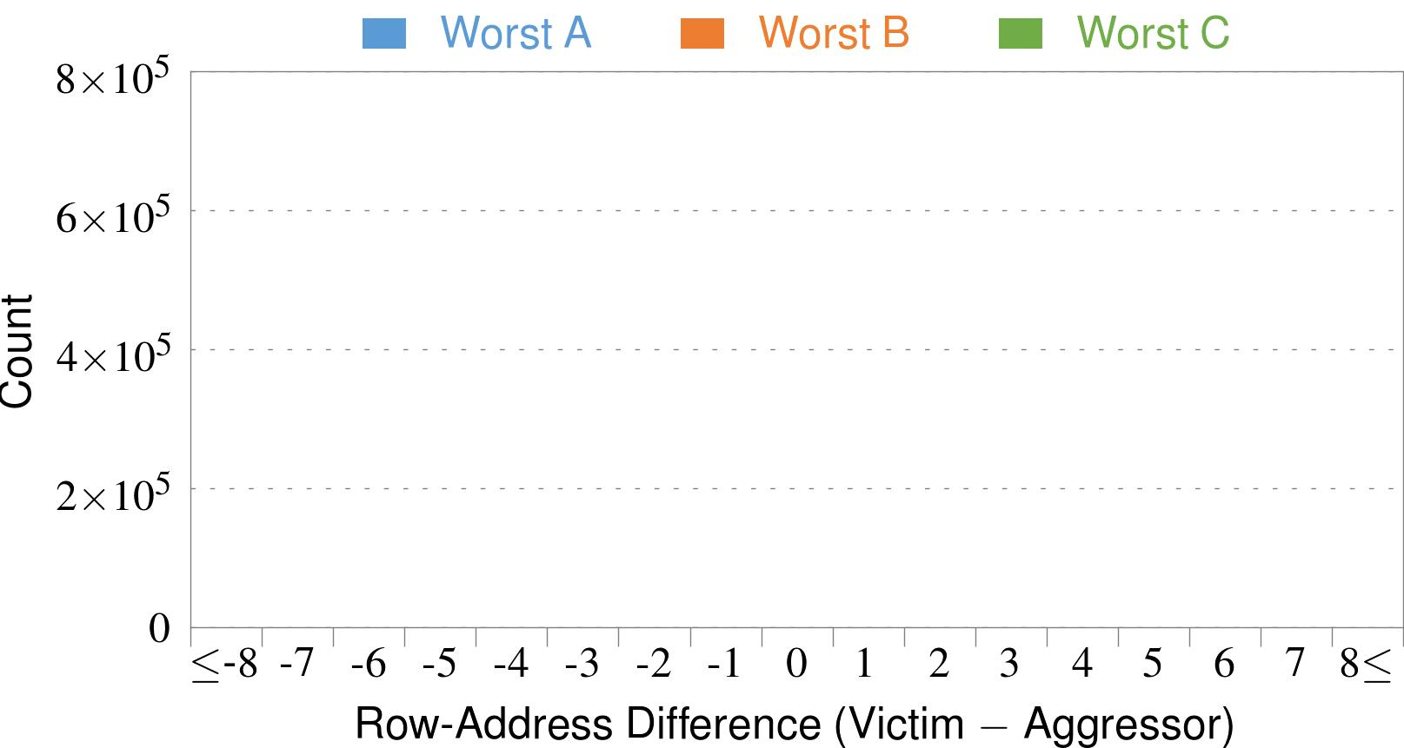

4. Adjacency: Aggressor & Victim
Adjacent
Adjacent
Adjacent
Non-Adjacent
Non-Adjacent
Note: For three modules with the most errors (only first bank)
Most aggressors & victims are adjacent
Notes:
In this figure, the x-axis is the row-address difference between an aggressor and its victims. And the y-axis is the number of victim-aggressor pairs that correspond to the row-address difference. For all three modules, we see strong peaks at plus/minus 1. This implies that aggressors and victims have consecutive row-addresses, in other words, they are adjacent.
However, the figure also shows some victims that are not adjacent to the aggressor. We believe this could be caused by two reasons. First, depending on the mapping, two rows that are physically adjacent within the DRAM chip may not have consecutive row-addresses. Second, fault rows are often re-mapped to spare rows that may reside on a different portion of the DRAM chip.
Nevertheless, we conclude that the vast majority of aggressors & victims are adjacent.

Slide 99


❶ Access Interval (Aggressor)
Not Allowed
500ns
55ns
Note: For three modules with the most errors (only first bank)
Less frequent accesses → Fewer errors
Notes:
In this figure, the x-axis is the interval at which we access the aggressor. And the y-axis is the number of errors. To comply with the DRAM standard, we employ a default value of 55ns in our experiments. However, as we increase the access-interval, we see that the number of errors decreases. In particular, at 500ns, there are no errors for all three modules.
From this, we conclude that less frequent accesses induce fewer errors.

Slide 100


❷ Refresh Interval
~7x frequent
64ms
Note: Using three modules with the most errors (only first bank)
More frequent refreshes → Fewer errors
Notes:
In this figure, the x-axis is the refresh-interval. And the y-axis is the number of errors. To comply with the DRAM standard, we employ a default value of 64ms in our experiments. However, as we decrease the refresh-interval, we see that the number of errors decreases. In particular, when the refresh is shortened by 7x, there are no errors for all three modules.
From this, we conclude that more frequent accesses induce fewer errors.

Slide 101
❸ Data Pattern
Solid
RowStripe
111111
111111
111111
000000
111111
111111
10x Errors
111111
000000
~Solid
~RowStripe
000000
000000
000000
111111
000000
000000
000000
111111
Errors affected by data stored in other cells
Notes:
We tested the modules with four different data-patterns: Solid, inverse Solid, RowStripe, and inverse RowStripe. Solid and inverse Solid give us full coverage since each cell is tested with both 1s and 0s. And the same applies to RowStripe and its inverse.
However, we found that the rowstripe pattern had 10 times as more errors than the solid pattern. We also tested many other data-patterns, including random, but found RowStripe to induce the most errors.
Therefore, we conclude that errors are affected by data stored in other cells due to differences in coupling effects between the cells.

Slide 102
6. Other Results (in Paper)
Victim Cells ≠ Weak Cells (i.e., leaky cells)
Almost no overlap between them
Errors not strongly affected by temperature
Default temperature: 50°C
At 30°C and 70°C, number of errors changes <15%
Errors are repeatable
Across ten iterations of testing, >70% of victim cells had errors in every iteration
Notes:
First, we show that victim cells are not weak cells, which are cells that are inherently leaky. According to our experiments, we saw almost no overlap between them.
Second, we show that errors are not strongly affected by temperature. In all of the tests so far, we set the temperature to 50 degrees Celsius. But even when we changed the temperature by 20 degrees, the number of errors changed by less than 15 percent.
Third, we show that errors are repeatable. Across ten iterations of testing, more than 70% of victim cells had errors in every iteration.

Slide 103
6. Other Results (in Paper) cont’d
As many as 4 errors per cache-line
Simple ECC (e.g., SECDED) cannot prevent all errors
Number of cells & rows affected by aggressor
Victims cells per aggressor: ≤110
Victims rows per aggressor: ≤9
Cells affected by two aggressors on either side
Very small fraction of victim cells (<100) have an error when either one of the aggressors is toggled
Notes:
Fourth, we show that there are as many as four errors per cacheline. From this, we conclude that simple ECC schemes (for example, SECDED) cannot prevent all errors.
Fifth, we show that the number of cells & rows affected by an aggressor can be as high as 110 or 9, respectively.
Lastly, we show that a very small fraction of victim cells experience an error when either one of the aggressors is toggled.

Slide 104
Some Potential Solutions
Cost
Make better DRAM chips
Power, Performance
Refresh frequently
Cost, Power
Sophisticated ECC
Cost, Power, Complexity
Access counters
Notes:
Here is a list of four potential solutions to disturbance errors: making better DRAM chips, refreshing more frequently, employing sophisticated ECC schemes, and using hardware counters to track the number of accesses to different rows.
However, all of these solutions incur a large overhead in terms cost, power, performance, and/or complexity.

Slide 105
How Do We Solve The Problem?
Fix it: Make DRAM and controllers more intelligent
New interfaces, functions, architectures: system-DRAM codesign
Eliminate or minimize it: Replace or (more likely) augment DRAM with a different technology
New technologies and system-wide rethinking of memory & storage
Embrace it: Design heterogeneous memories (none of which are perfect) and map data intelligently across them
New models for data management and maybe usage
…
Problems
Algorithms
Programs
User
Runtime System
(VM, OS, MM)
ISA
Microarchitecture
Logic
Devices
Solutions (to memory scaling) require
software/hardware/device cooperation

Slide 106
Naive Solutions
❶ Throttle accesses to same row
Limit access-interval: ≥500ns
Limit number of accesses: ≤128K (=64ms/500ns)
❷ Refresh more frequently
Shorten refresh-interval by ~7x
Both naive solutions introduce significant overhead in performance and power
Notes:
Based on what we learned from the sensitivity studies, there are two naive solutions that immediately present themselves.
First, we can throttle accesses to the same row. If the access-interval is greater than 500ns, I showed how errors are not induced. We can achieve the same effect by limiting the maximum number of accesses to the same row to be less than 128K, within a refresh interval.
Second, we can refresh the module more frequently. If the refresh-interval is shortened by 7x, I showed how errors can be prevented.
However, both naive solutions introduce significant overhead in both performance and power. Later on, I will propose a much more efficient solution.

Slide 107

Apple’s Patch for RowHammer
https://support.apple.com/en-gb/HT204934
HP and Lenovo released similar patches

Slide 108
One Solution: PARA: Probabilistic Adjacent Row Activation
Key Idea
After closing a row, we activate (i.e., refresh) one of its neighbors with a low probability: p = 0.005
Reliability Guarantee
When p=0.005, errors in one year: 9.4×10⁻¹⁴
By adjusting the value of p, we can vary the strength of protection against errors
Notes:
We provide a more efficient solution, called PARA, which stands for probabilistic adjacent row activation.
The key idea is thus: after closing a row, we activate (i.e., refresh) one of its neighbors with a low probability, for example, p equal to 0.005.
PARA provides a strong reliability guarantee even under the worst-case access patterns to DRAM. When we set p to 0.005, the expected number of errors in one year is 9.4 times 10 to the negative 14. This probability is much lower the failure rate of other hardware components, for example, the hard-disk drive.
And by adjusting the value of p, PARA can provide an arbitrarily strong-degree of protection against errors.

Slide 109
Advantages of PARA
PARA refreshes rows infrequently
Low power
Low performance-overhead
Average slowdown: 0.20% (for 29 benchmarks)
Maximum slowdown: 0.75%
PARA is stateless
Low cost
Low complexity
PARA is an effective and low-overhead solution to prevent disturbance errors
Notes:
PARA has many advantages. Since it refreshes row infrequently, it has low power and low performance-overhead. Simulated across 29 benchmarks, we saw an average of only 0.2% slowdown and a maximum of only 0.75% slowdown.
In addition, due to its stateless nature, PARA has low cost and complexity.
Therefore, PARA is an effective and low-overhead solution to prevent disturbance errors.

Slide 110


Slide 111

ANVIL: Software-Based Protection Against Next-Generation Rowhammer Attacks
Zelalem Aweke†, Salessawi Yitbarek†, Rui Qiao‡, Reetuparna Das†, Matthew Hicks†, Yossi Oren∗, and Todd Austin†
† University of Michigan ‡ Stony Brook University ∗ Ben-Gurion University of the Negev
ASPLOS 2016, Atlanta, GA, April 6, 2016

Slide 112
ANVIL setup
DRAM Bank
Process 1
Process n
…
Linux
ANVIL
Processor
H/W Performance Counters
…
Notes:
Finally we present a robust a software-based rowhammering attack mitigation technique, ANVIL. Anvil detects rowhammering attacks by monitoring cache misses out of the LLC using existing performance counter features. Up

Slide 113
Intuition
An attacking process using Rowhammer will lead to predictable patterns
Need cache misses to ensure DRAM is accessed
Many accesses to the the same or nearby DRAM rows

Slide 114

Our Solution: ANVIL
DRAM Bank
Process 1
Process n
…
Linux
ANVIL
Processor
H/W Performance Counters
…
Notes:
Finally we show a robust ANVIL a software-based rowhammering attack mitigation technique. Anvil detects rowhammering attacks by monitoring cache misses out of the LLC using existing performance counter features. Up

Slide 115
Alternative Rowhammer Mitigations
Double refresh rate
Lessens time to produce bit flips
e.g. HP, Lenovo
Shown to be ineffective
Disallow CLFLUSH instruction
No quick access to DRAM due to caches
e.g. Google Chrome
Is this technique effective?
Notes:
One proposal to mitigate rowhammering techniques is doubling the DRAM refresh rate (or reducing the refresh period from 64ms to 32ms). This reduces the time available for Rowhammering, but as Kim et. al‘s study showed and as we confirm in this work, bit flips can be induced in a time much less than 32ms.
Another approach is disallowing the CLFLUSH instruction which is used by all rowhammering attacks to accelerate the Rowhammering process. For example, Google’s Native Client, which is part of Google Chrome, does this. But does this technique really STOP rowhammering attacks? The answer is no.

Slide 116
CLFLUSH-free Rowhammer Attack
Rowhammering creates locality that caches filter
Use conflicting misses out of the last-level cache (LLC) to access DRAM
Create eviction set
Create access pattern that misses on target address
DRAM Bank
L3 Cache
…
Row 0
Aggressor Row1
CPU
L1 Cache
L2 Cache
Row 1
Victim Row
Row 2
Aggressor Row2
…
Row-buffer
Notes:
The challenge here is the high locality of aggressor row accesses which is filtered by caches. Modern high end processors typically include three levels of cache. We need a way of bypassing the caches without explicitly flushing them. One way of doing this is using conflicting misses out of the last-level cache. We do this by first creating an eviction set that contains addresses that belong to the same cache set. Then we create a memory access pattern that allows us to miss the LLC at our desired addresses.

Slide 117
CLFLUSH-free Rowhammer Attack
Eviction Set
DRAM Bank
A0
…
X1
Row 0
Aggressor Row1
Inclusive LLC
X2
…
Row 1
Victim Row
…
Row 2
Set X
…
Aggressor Row2
Xn
…
Row-buffer
Eviction set size depends on number of ways in cache set
Notes:
Let us take for example a case where we have an Inclusive LLC (meaning the LLC contains copies of upper levels of caches, such that evicting data from the LLC also evicts the corresponding data in L1 and L2 caches). Also let us assume a double-sided Rowhammering attack, where Row0 and Row 2 are aggressor rows and Row 1 is a victim row. Our goal here is to repeatedly access Row 0 and Row2 without using the CLFLUSH instruction. Here I will only show an example for Row 0, but same principle works for Row2 as well.
So the first step is creating an eviction set (CLICK) by first picking an address that maps to an Row 0. (CLICK) Let’s say this address maps to setx in the LLC. (CLICK) Then we add more addresses into the eviction set by picking addresses that map to setx in the LLC. The number of addresses depends on the number of ways? In the LLC. (CLICK)Then after creating the eviction set we can accesses data at each addresses one by one to evict data at the aggressor address in the LLC and access the aggressor row.

Slide 118
CLFLUSH-free Rowhammer Attack
Eviction Set
DRAM Bank
A0
…
X1
Row 0
Aggressor Row1
Inclusive LLC
X2
…
Row 1
Victim Row
…
Row 2
Set X
…
Aggressor Row2
Xn
…
Row-buffer
Eviction set size depends on number of ways in cache set

Slide 119
CLFLUSH-free Rowhammer Attack
Eviction Set
DRAM Bank
A0
…
X1
Row 0
Aggressor Row1
Inclusive LLC
X2
…
Row 1
Victim Row
…
Row 2
Set X
…
Aggressor Row2
Xn
…
Row-buffer
Eviction set size depends on number of ways in cache set

Slide 120
CLFLUSH-free Rowhammer Attack
Eviction Set
DRAM Bank
A0
…
X1
Row 0
Aggressor Row1
Inclusive LLC
X2
…
Row 1
Victim Row
…
Row 2
Set X
…
Aggressor Row2
Xn
…
Row-buffer
Eviction set size depends on number of ways in cache set

Slide 121
CLFLUSH-free Rowhammer Attack
Eviction Set
DRAM Bank
A0
…
X1
Row 0
Aggressor Row1
Inclusive LLC
X2
…
Row 1
Victim Row
…
Row 2
Set X
…
Aggressor Row2
A0
Xn
…
Row-buffer
Eviction set size depends on number of ways in cache set

Slide 122
CLFLUSH-free Rowhammer Attack
Eviction Set
DRAM Bank
A0
…
X1
Row 0
Aggressor Row1
Inclusive LLC
X2
…
Row 1
Victim Row
…
Row 2
Set X
…
Aggressor Row2
A0
Xn
…
Row-buffer
Eviction set size depends on number of ways in cache set

Slide 123
CLFLUSH-free Rowhammer Attack
Eviction Set
DRAM Bank
A0
…
X1
Row 0
Aggressor Row1
Inclusive LLC
X2
…
Row 1
Victim Row
…
Row 2
Set X
…
Aggressor Row2
A0
Xn
…
Row-buffer
Eviction set size depends on number of ways in cache set

Slide 124
CLFLUSH-free Rowhammer Attack
Eviction Set
DRAM Bank
A0
…
X1
Row 0
Aggressor Row1
Inclusive LLC
X2
…
Row 1
Victim Row
…
Row 2
Set X
…
Aggressor Row2
Xn
…
Row-buffer
Eviction set size depends on number of ways in cache set

Slide 125
CLFLUSH-free Rowhammer Attack: Implementation
Test hardware – Intel Sandy Bridge
12-way inclusive LLC
13 addresses in the eviction set
(A0 and X1 – X12)
Efficient access pattern – a function of replacement policy
Sandy Bridge uses Bit-PLRU policy
Miss
Hit
Miss
Hit
A0→X1…→X9→X10→X11→X1…→X9→X12
Measured A0 to A0 latency :≈340 ns at 2.6GHz
125
Notes:
We implemented the CLFLUSH-free rowhammering attack on an Intel processor with Sandy Bridge microarchitecture. The processor has a 12-way inclusive last level cache, therefore the eviction set contains 12 addresses in addition to the target aggressor address (A0).
The next question is, what access pattern should we use so that we can achieve thousands of aggressor row accesses within a refresh period. An efficient access pattern exhibits the minimum number of unnecessary LLC misses. To achieve an efficient access pattern, it is important to know the LLC replacement policy. However, the cache replacement policy for Sandy Bridge is not publicly disclosed, so we did an offline analysis using CPU performance counters to identify the policy. Through our analysis, we found that Sandy Bridge uses a variant of LRU policy called Bit-PLRU.
Under Bit-PLRU, this pattern provides an efficient access to the aggressor row, only missing at the aggressor address and one additional address. On our test machine this access pattern gave an average of 340 ns per aggressor row address.

Slide 126
Experimental Evaluations
Test platform
Intel Sandy Bridge, Core i5-2540M processor
Ubuntu 14.04 LTS
Hammer Technique | Minimum No. of Row Accesses to bit flip | Time to First Bit Flip
Single-sided with CLFLUSH | 400k | 58ms
Double-sided with CLFLUSH | 220K | 15ms
Double-sided without CLFLUSH | 220K | 45ms
Double-sided with CLFLUSH can produce bit flips with in 4x refresh rate
Notes:
We evaluated three types of Rowhammering techniques based the number of row accesses required to induce bit flips and the time before the first bit flip. We used an Intel Core i5-2540M processor running Ubuntu 14.04 for our evaluation. As you can see from the results, double-sided Rowhammering requires much less number of accesses as compared to single-sided Rowhammering, that is why our CLFLUSH-free Rowhammering performs better than the CLFLUSH-based single sided Rowhammering. Another thing to note here is that the CLFLUSH-based double-sided Rowhammering only required 15ms for the first bit flip, which means even if the refresh rate is increased by 4X there is still a possibility of inducing bit flips.

Slide 127
Detecting Rowhammering Attacks
Thousands of aggressor row accesses within a refresh period
High LLC miss rate
High memory access locality
Need to flush row-buffer
High bank locality
Notes:
If we look at a Rowhammering attack characteristics, we can see that it has some peculiar behavior. It requires thousands of the same aggressor row accesses within a refresh period, therefore we expect a high LLC miss rate and a high memory access locality. This contradicts with regular memory access characteristics where high memory access locality should result in low LLC miss rate. Also, due to the need to flush the row buffer, Rowhammering exhibits a high bank locality among DRAM accesses. Therefore, we can use these characteristics to detect Rowhammering attacks. All we need is an efficient way of detecting these behaviors, and as it turned out performance counters on modern CPUs can provide us with this capability.

Slide 128
Software-based Rowhammering Attack Detection
Process 1
Process n
ANVIL resides in the Kernel to allow:
Unfettered access to performance counters
Access to all DRAM
Performance counters available on Intel Sandy Bridge and later microarchitectures
Similar capabilities on AMD processors
Linux
ANVIL
Software
Linear Address
L3 Miss Count
Selective Refresh
Processor
H/W Performance Counters
DRAM
Hardware
Notes:
So based on this idea, we propose ANVIL, a software based rowhammering detection and protection mechanism. ANVIL gets LLC miss rate and memory access locality information from hardware performance counters in the processor. It processes this information to determine if there is a rowhammering activity. Once it detects a potential rowhammering activity, it protects potential victim rows by selectively refreshing them. The refreshing is done by simply reading a word from the potential victim rows.
The performance counter features we use are available on Intel Sandy Bridge and later microarchtectures. AMD processors also include similar features, therefore ANVIL can be implemented on such processors.
ANVIL is a Kernel extension, therefore it has unlimited access to performance counters and information about currently running processes.

Slide 129
ANVIL’s Detection Process
Monitor LLC Miss Rate
Phase 1: Monitor LLC Miss Rate
Is miss rate high enough ?
Solution: Monitor LLC miss count
High Miss Rate?
No
Yes
Sample LLC Miss Addresses
Phase 2: Sample LLC Miss Addresses
Do misses have high row and bank locality?
Solution: Sample misses out of LLC
Determine DRAM Rows of Samples
High Row Locality?
No
Phase 3: Remedy
How to protect potential victim rows?
Solution: Selectively refresh rows
Yes
Determine Potential Victim DRAM Rows
Selectively Refresh Potential Victim DRAM Rows
Notes:
This flow chart shows ANVIL’s detection process in some detail. The detection process has two phases. [In the first phase, ANVIL analyses the LLC miss rate looking for a rate high enough that could potentially rowhammer the DRAM. In the second phase samples of memory accesses that missed the LLC are analyzed to see if there is a high locality.] Normally ANVIL stays in the first phase using the LLC miss count to determine the miss rate over a fixed amount of time. If the rate is low, ANVIL stays in the first phase reinitiating the process over and over again. Once the rate crosses a threshold high enough to potentially be a rowhammer, phase two samples DRAM row accesses looking for high row locality. If there is a high row locality, then ANVIL considers it as rowhammering and initiates a selective refresh on the potential victim rows. Once the locality is gone, we shift back to phase one looking for high miss rate again.

Slide 130
Experimental Evaluation
Test platform
Intel Sandy Bridge, Core i5-2540M processor
Ubuntu 14.04 LTS with Linux 4.0.0
Benchmarks
Rowhammering programs
CLFLUSH_hammer and CLFLUSH-free_hammer
SPEC2006 integer benchmarks
Notes:
We implemented ANVIL as a kernel module and tested it on Sandy Bridge based processor running Ubuntu 14.04 with Linux 4.0. We tested for rowhammer detection accuracy and overhead incurred by the detection process. To test for detection accuracy we used two rowhammering programs, one with CLFLUSH instruction and another with out. We used SPEC integer benchmarks to measure ANVIL’s overhead.

Slide 131
Rowhammer Detection
ANVIL-baseline parameters
Detection for lightly and heavily loaded conditions
LLC_MISS_THRESHOLD | 20K
Miss Count Duration (tc) | 6ms
Sampling Duration (ts) | 6ms
rowhammer + mcf + libquantum + omnetpp
Benchmark | Max. Time to Detect | Min. Time to Flip | Refreshes per 64ms | Total Bit Flips
CLFLUSH (Heavily loaded) | 13.2 ms | 15ms | 12.35 | 0
CLFLUSH (Lightly loaded) | 12.8 ms | 15ms | 10.3 | 0
CLFLUSH-free (Heavily loaded) | 38.09 ms | 45ms | 4.53 | 0
CLFLUSH (Lightly loaded) | 23.53 ms | 45ms | 5.10 | 0
<
<
<
<
Notes:
For our tests we set some parameter of ANVIL as shown in the table. The first parameter is the LLC miss threshold that would trigger the second phase of detection. The next two parameters determine the durations for the two phases. These values are set based on our empirical analysis of rowhammering programs [ i.e. the minimum number of memory accesses and the amount of time required to flip bits]
We tested the detection process for two settings. The first is when the rowhammring program is the only running program and the second is when some other programs from SPEC benchmarks run along with the rowhammering program. The second column in the second table shows the average time required to detect rowhammering, including the time required to perform selective refresh. As you can see from the results, ANVIL can detect rowhammering well a head of the time required to flip bits, therefore eliminating all potential bit flips. Another thing to note here is that the selective refresh rate is so small that, even if there are false positives, the protection maechanism can not accidentally rowhammer the potential victim rows.

Slide 132
Performance Impact on Non-malicious Programs
Average overhead of 1.17%
Can detect rowhammering that is 2x faster than can be prevented by double refresh rate
Paper details detection of more aggressive future attacks
Notes:
We also measured the performance overhead of ANVIL and compared it with the overhead of doubling the DRAM refresh rate. We used the same settings for ANVIL as the previous slide. As you can see from the graph, ANVIL has an average overhead of approximately 1% which is almost the same as that of doubling the refresh rate. But the advantage of ANVIL is that it can detect rowhammering that is twice as fast as that can be prevented by doubling refresh.
[Now there were some selective refreshes for these applications as well potentially due to false positives but the refresh rate is almost 0 and most importantly the refreshs are harmless.]
Finally, you might ask what happens if an attacker finds an efficient way of rowhammering. Well, ANVIL can adapt to such types of attacks by increasing the detection rate with a small increase in overhead . We have done analysis of such an accelerated detection process and I invite to look at our paper to find out more.

Slide 133
Conclusion
Existing rowhammer mitigation mechanisms are insufficient
Doubling refresh rate - Efficient rowhammering
Disallowing CLFLUSH - CLFLUSH-free rowhammering
Software-based mitigation using existing H/W performance counters can provide effective protection with low overhead
Notes:
So in conclusion, currently deployed rowhammering mitigation techniques, namely doubling the refresh rate and disallowing CLFLUSH instruction are not sufficient. Software-based mitigation using existing performance counters can provide better protection with low overhead.

Slide 134


Slide 135


Slide 136


Slide 137


Slide 138


Slide 139


Slide 140


Slide 141


Slide 142


Slide 143


Slide 144


Slide 145


Slide 146
Questions to consider
What would a “finite” version of other syscalls look like?
How would you decide which security approach to use?
Hardware vs. OS: who is responsible for protecting against attacks like Rowhammer?

